Slide 1

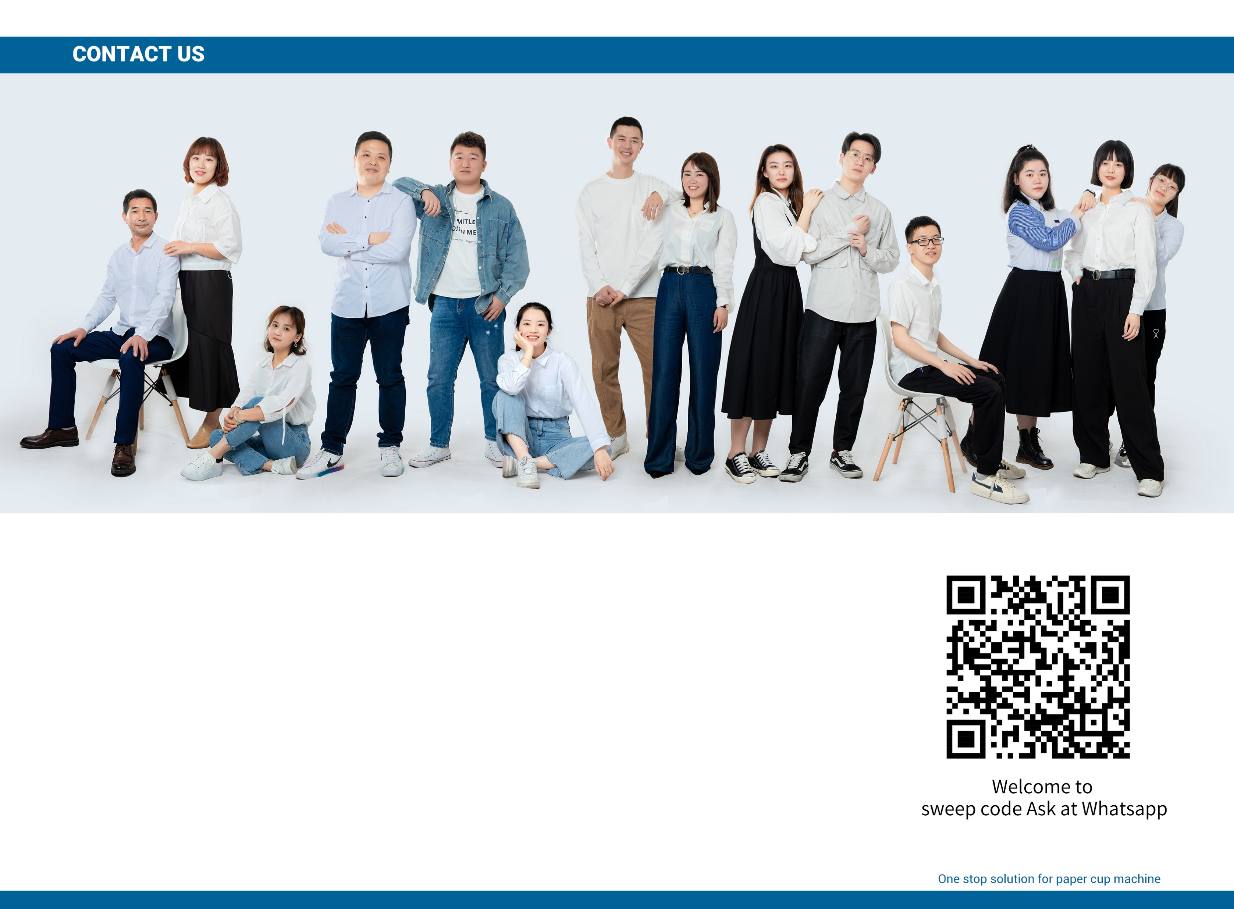
OPTIONAL EQUIPMENT
Contact: +8613506671537(wechat/whatapp)
Email: Betty@bettycdhk.com
Address: Room 2202, Unit 1, Building 12, Ruifengjingyuan, Anyang Street, Ruian City,
Wenzhou City, Zhejiang Province, China

Slide 2
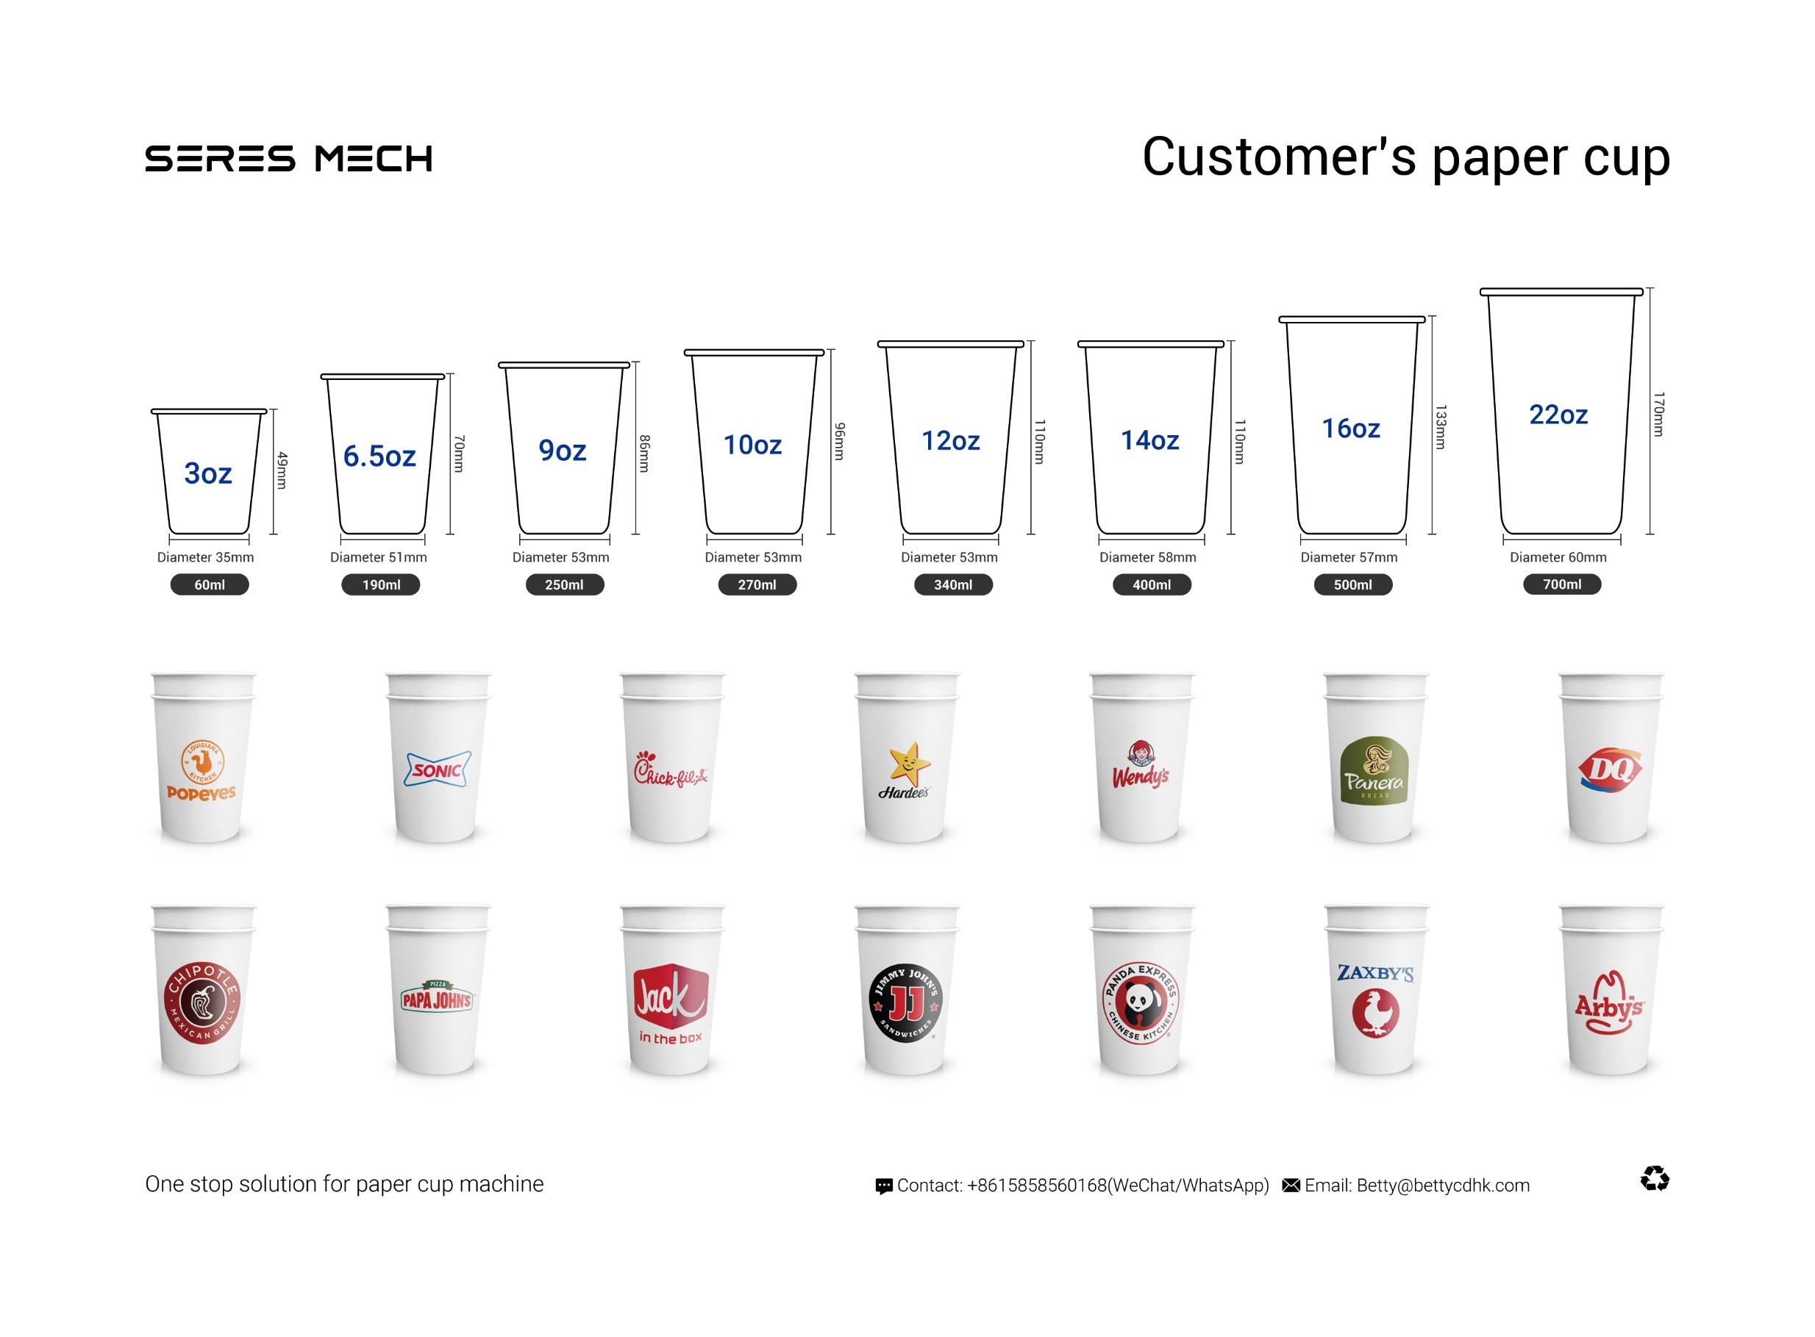
OPTIONAL EQUIPMENT
Contact: +8613506671537(wechat/whatapp)
Email: Betty@bettycdhk.com
Address: Room 2202, Unit 1, Building 12, Ruifengjingyuan, Anyang Street, Ruian City,
Wenzhou City, Zhejiang Province, China

Slide 3
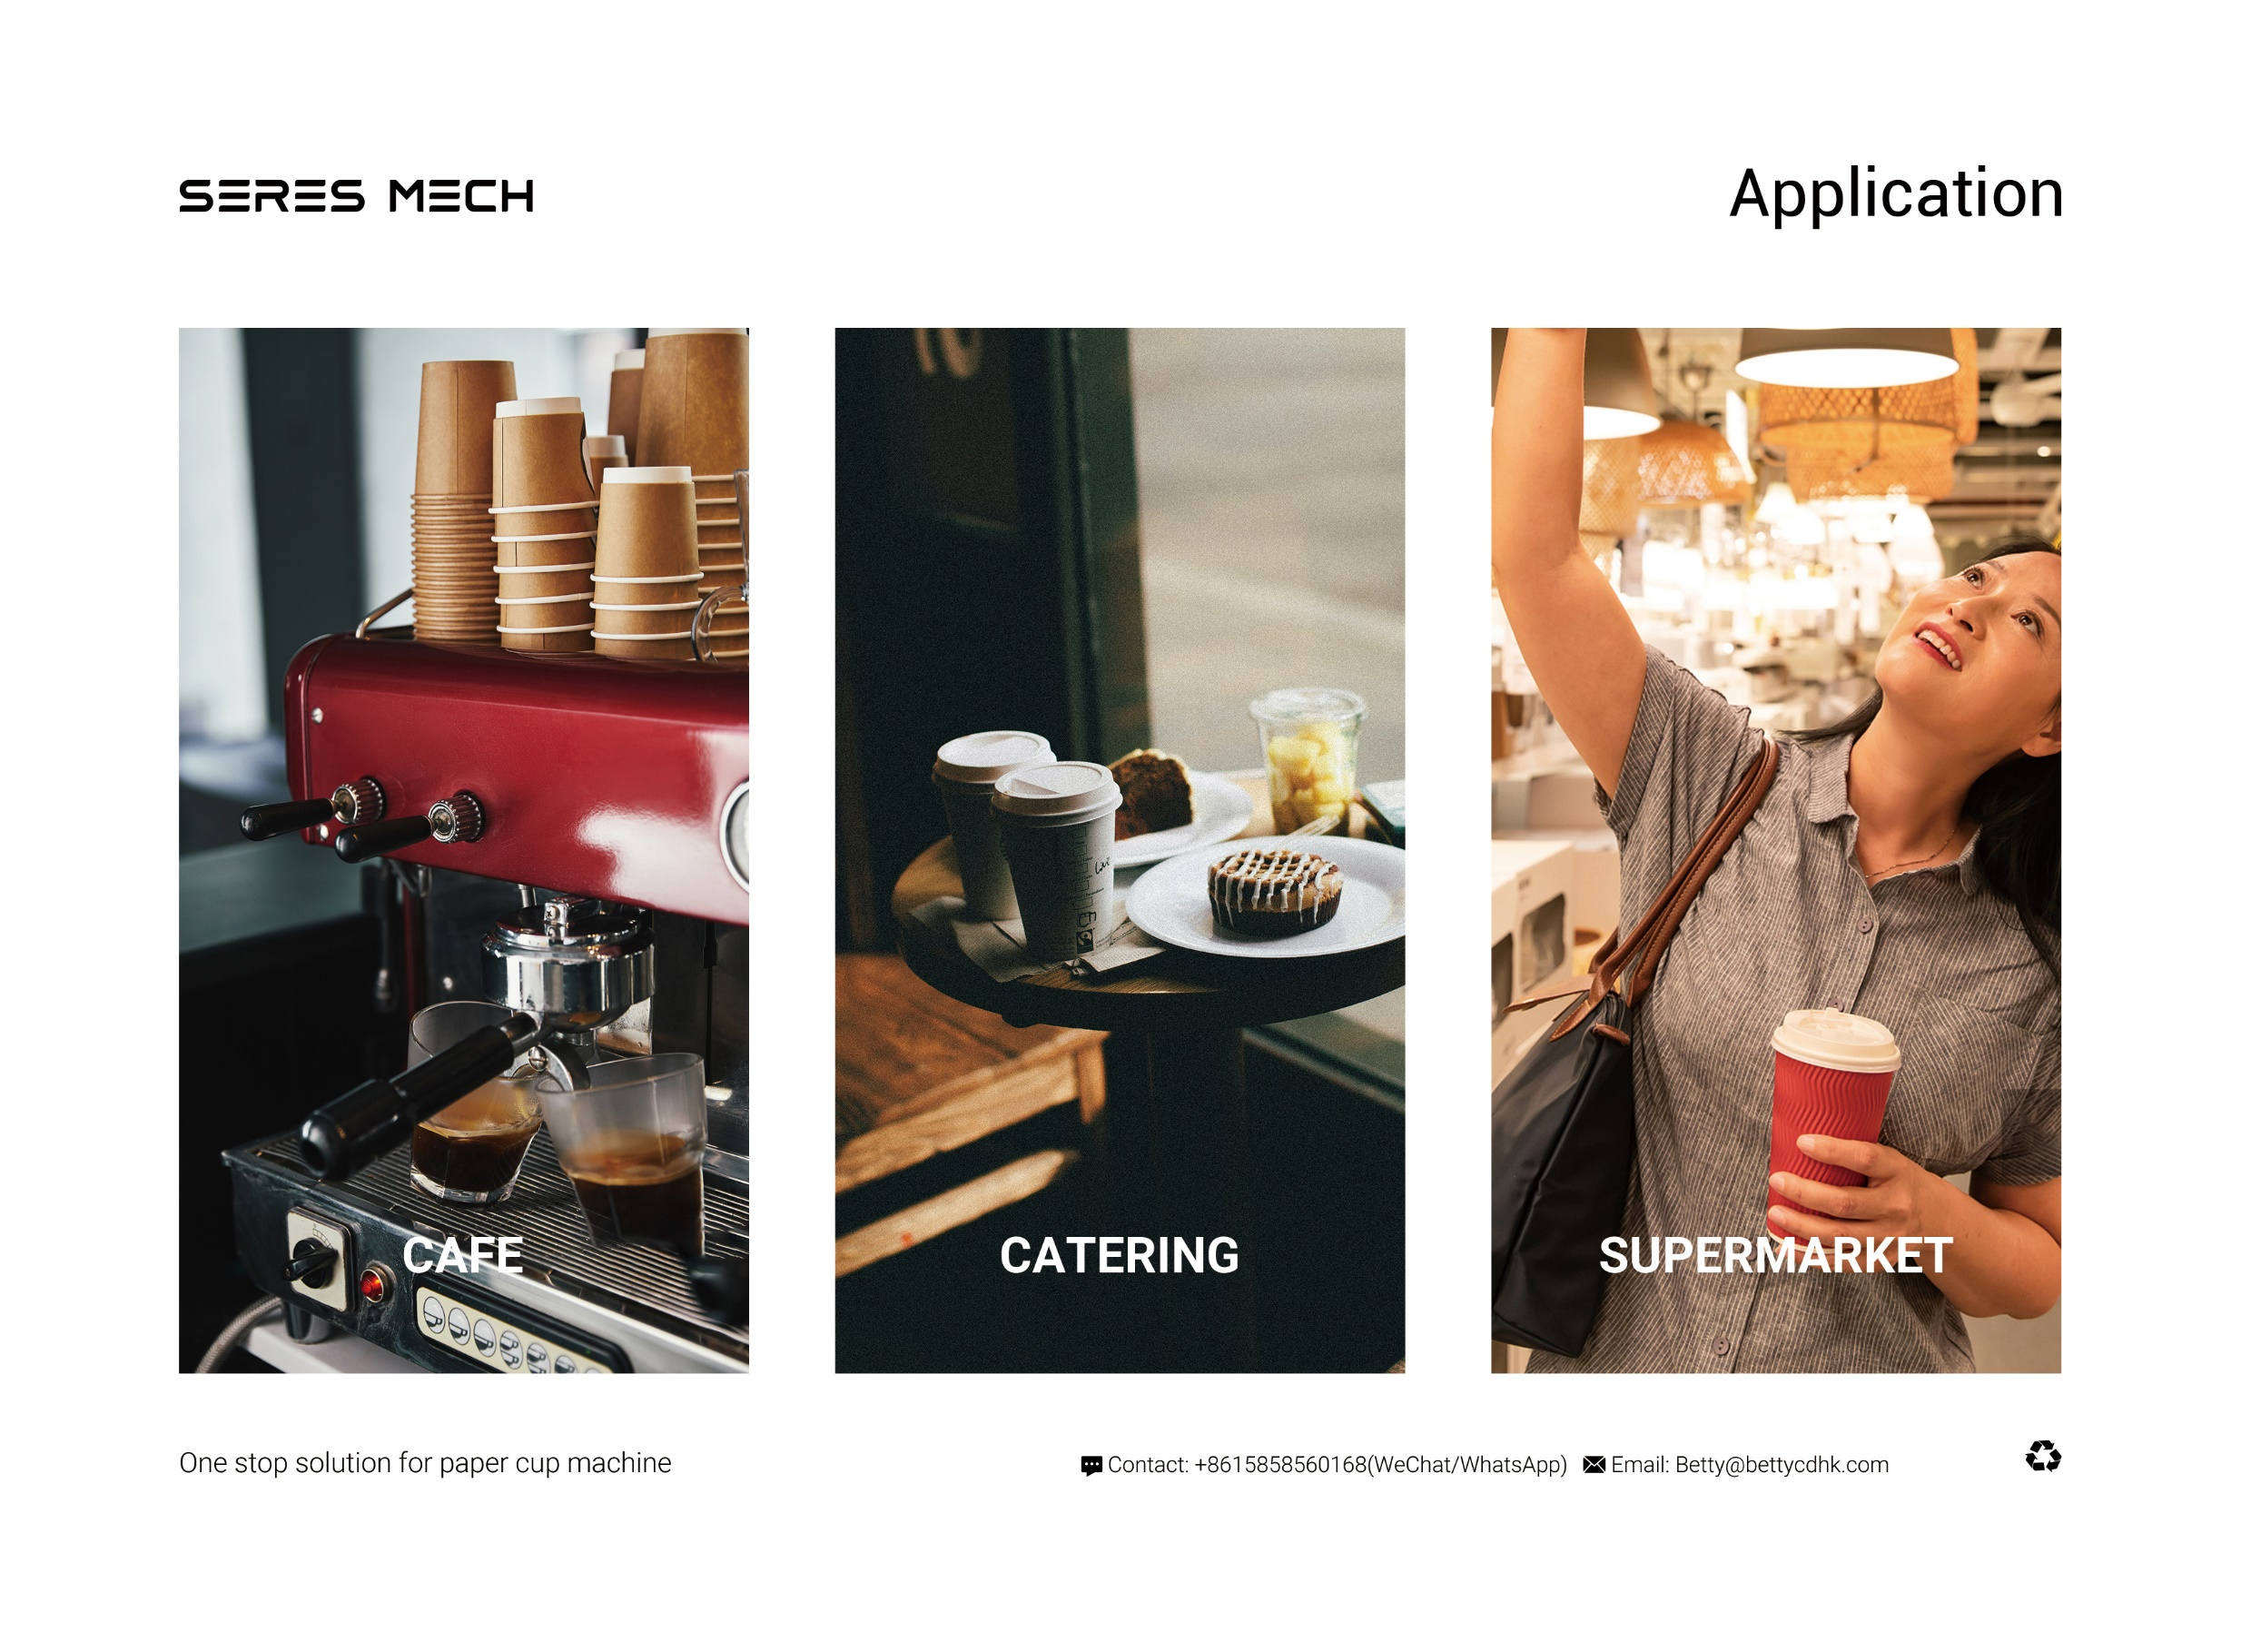
OPTIONAL EQUIPMENT
Contact: +8613506671537(wechat/whatapp)
Email: Betty@bettycdhk.com
Address: Room 2202, Unit 1, Building 12, Ruifengjingyuan, Anyang Street, Ruian City,
Wenzhou City, Zhejiang Province, China

Slide 4
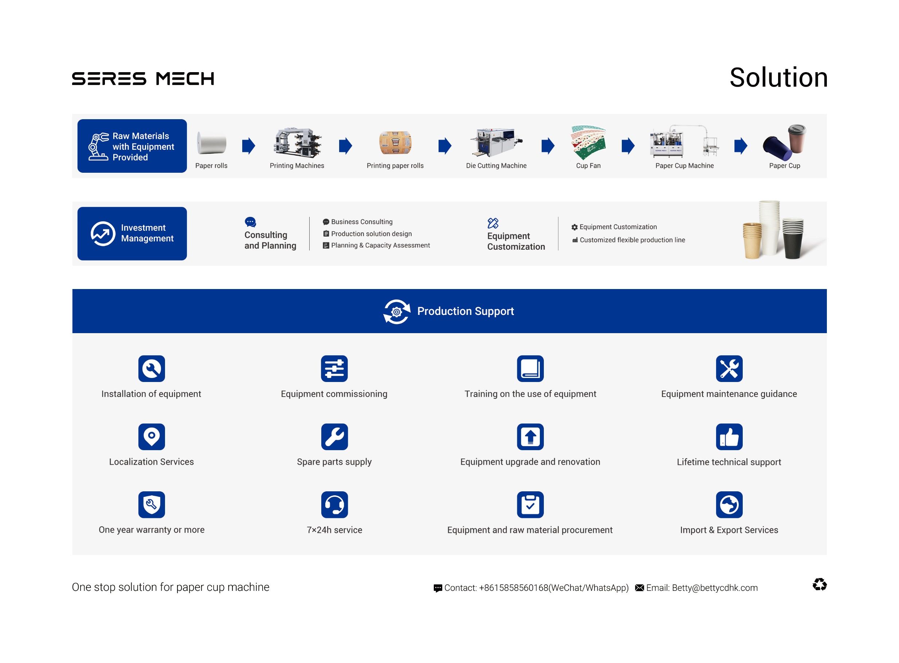
OPTIONAL EQUIPMENT
Contact: +8613506671537(wechat/whatapp)
Email: Betty@bettycdhk.com
Address: Room 2202, Unit 1, Building 12, Ruifengjingyuan, Anyang Street, Ruian City,
Wenzhou City, Zhejiang Province, China

Slide 5
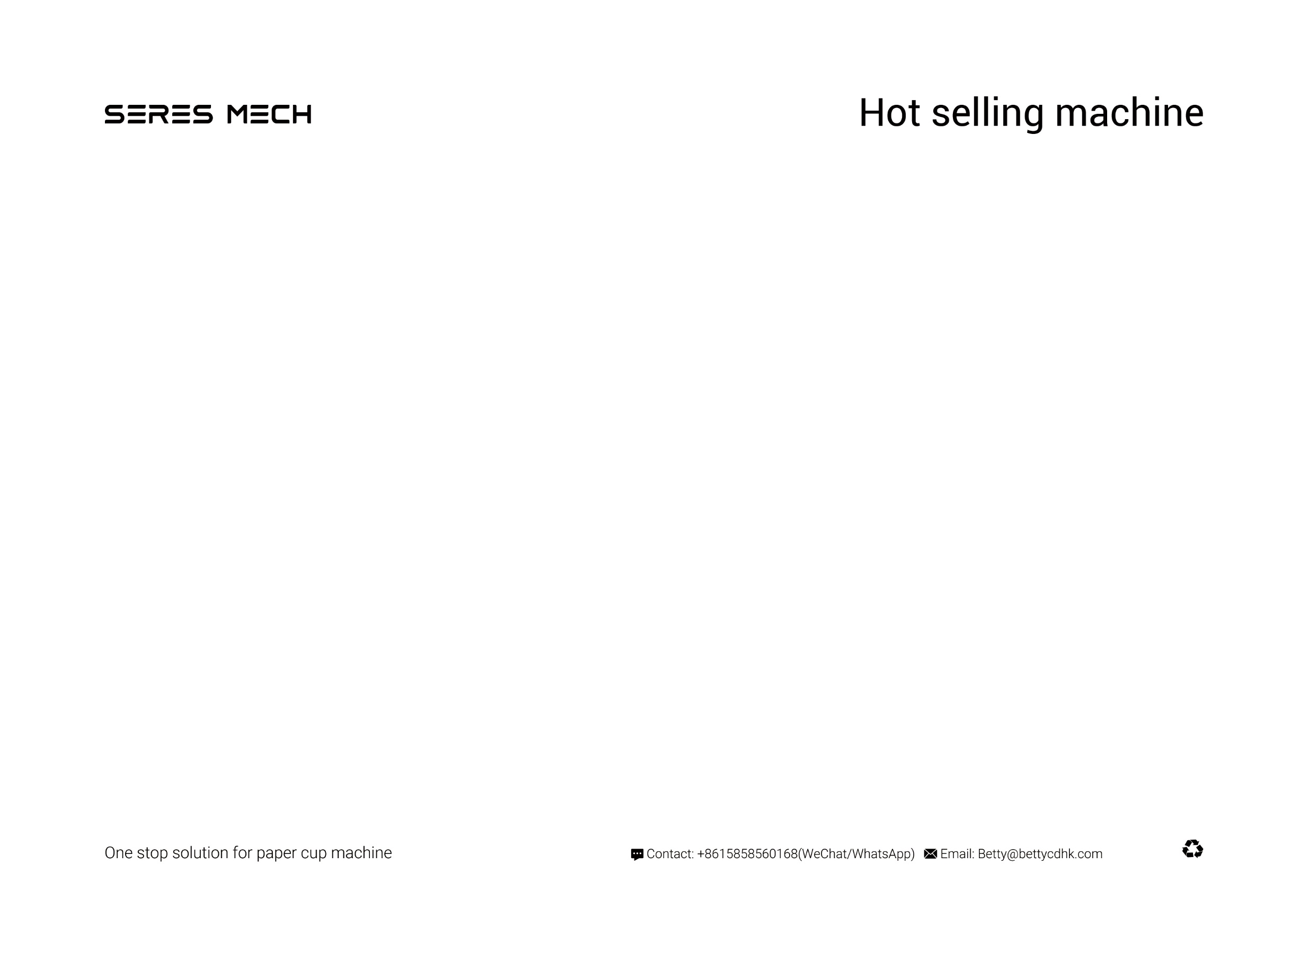
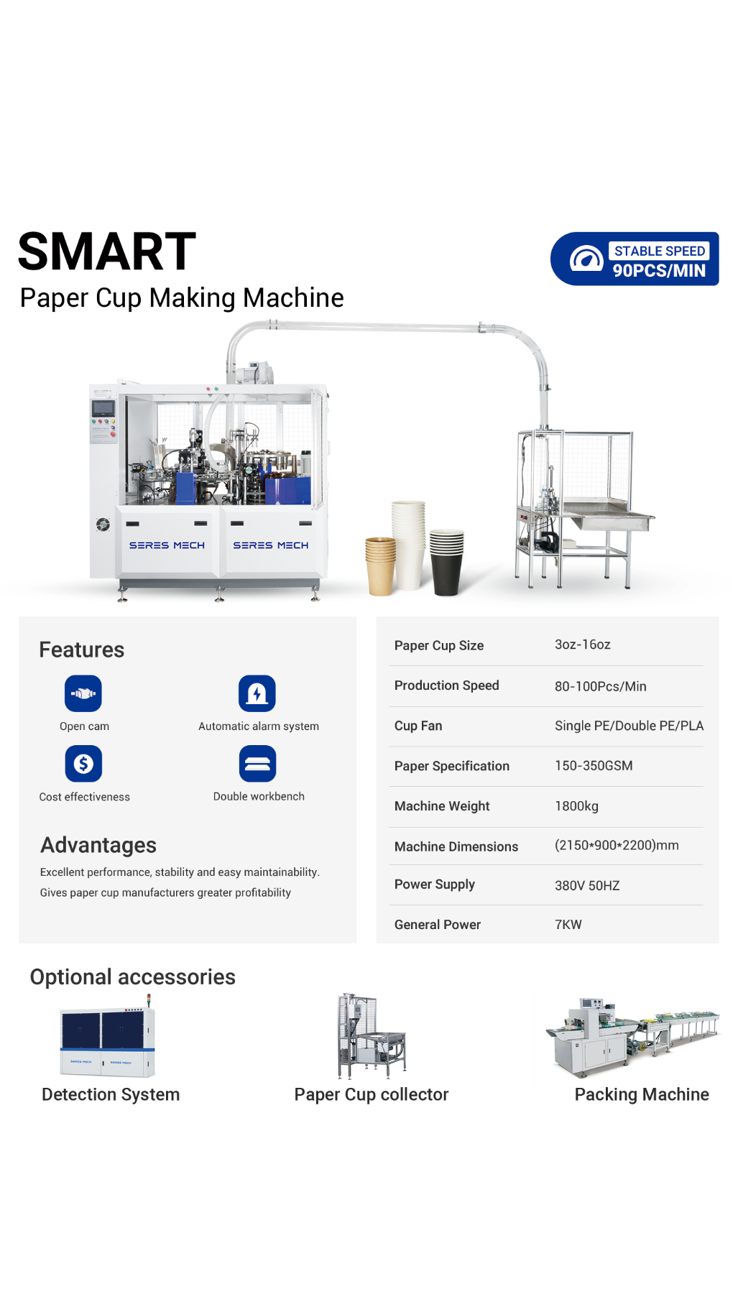
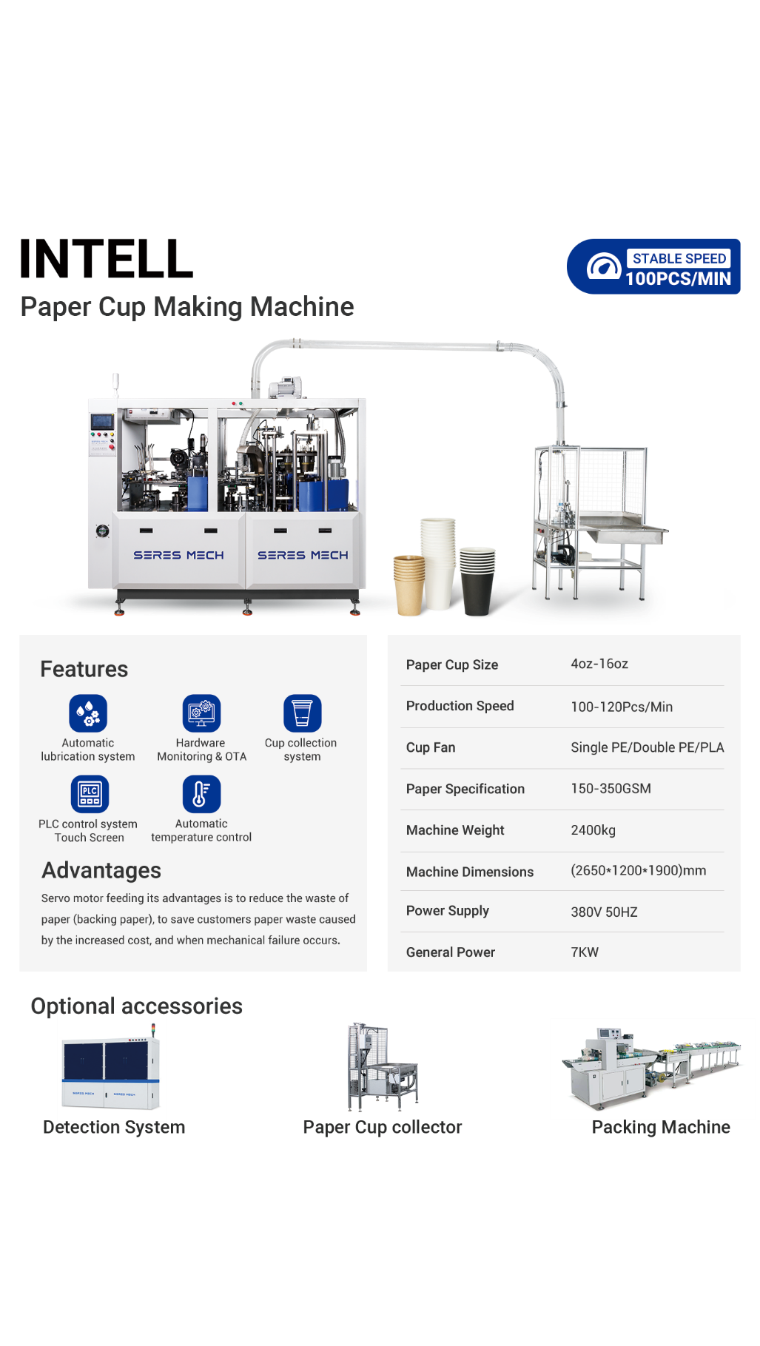
OPTIONAL EQUIPMENT
Contact: +8613506671537(wechat/whatapp)
Email: Betty@bettycdhk.com
Address: Room 2202, Unit 1, Building 12, Ruifengjingyuan, Anyang Street, Ruian City,
Wenzhou City, Zhejiang Province, China

Slide 6
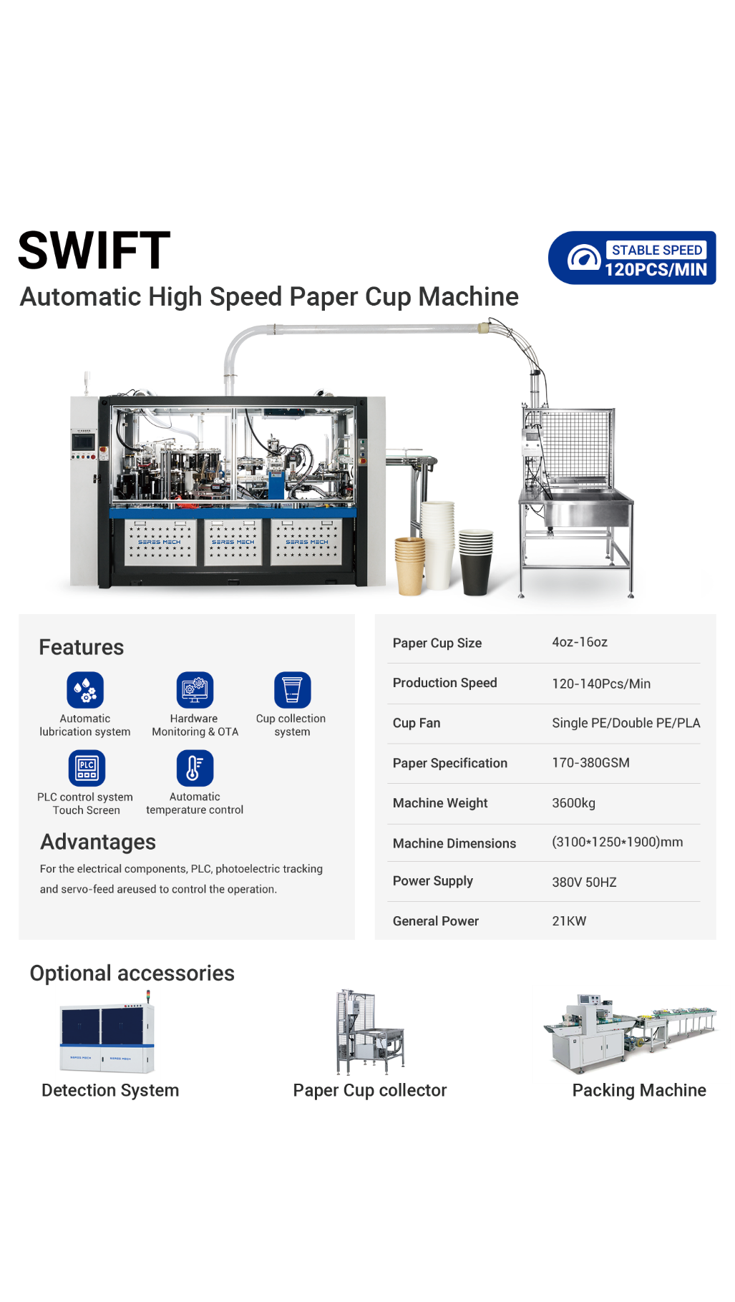
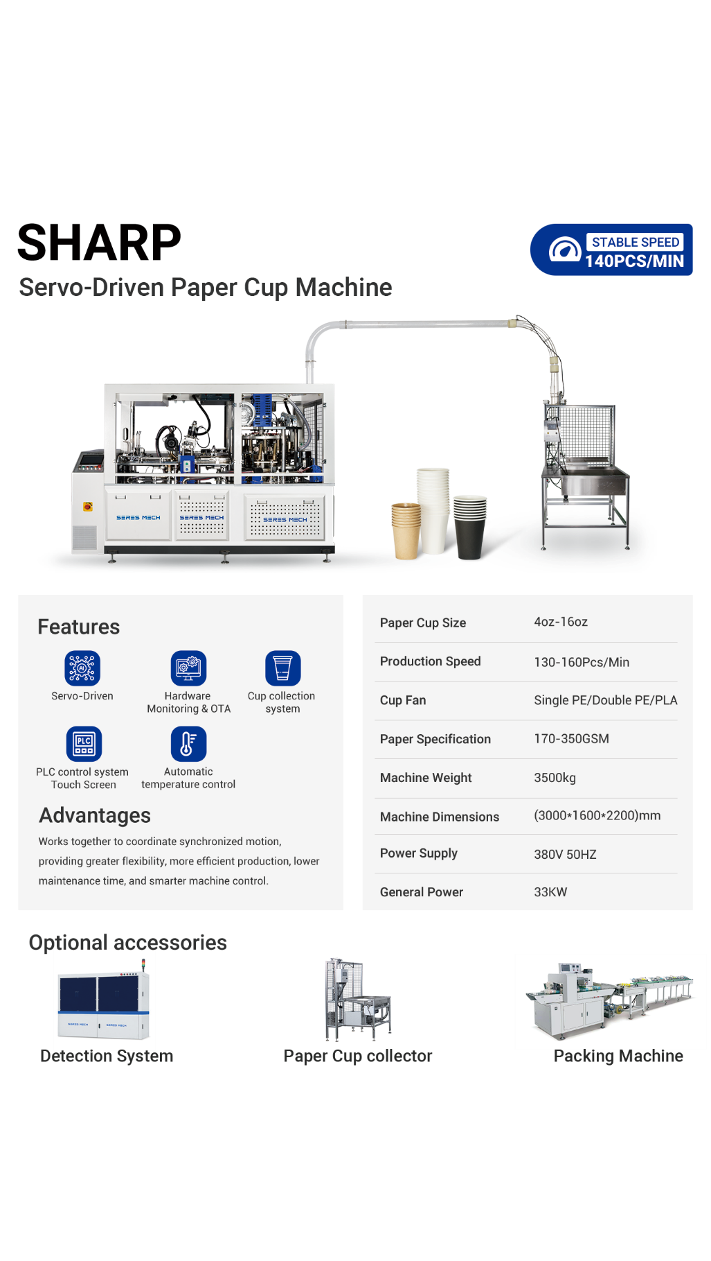
OPTIONAL EQUIPMENT
Contact: +8613506671537(wechat/whatapp)
Email: Betty@bettycdhk.com
Address: Room 2202, Unit 1, Building 12, Ruifengjingyuan, Anyang Street, Ruian City,
Wenzhou City, Zhejiang Province, China

Slide 7
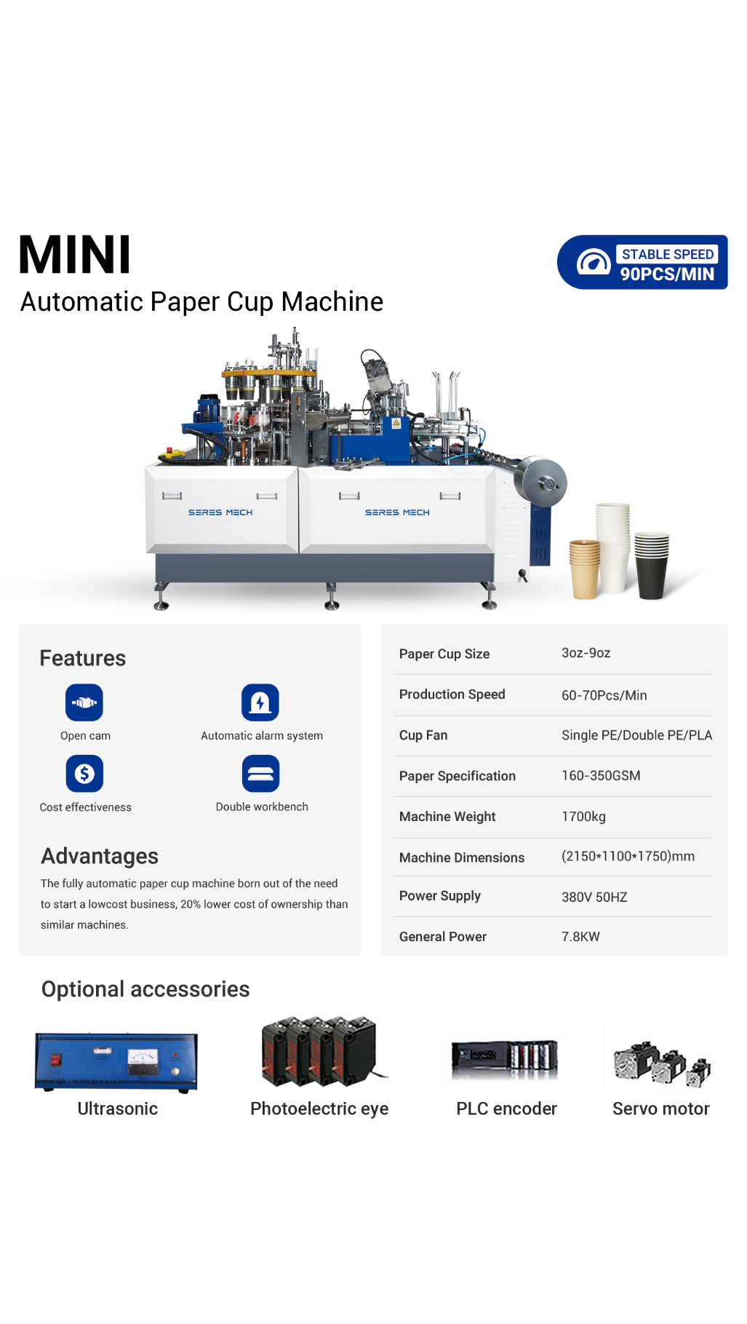
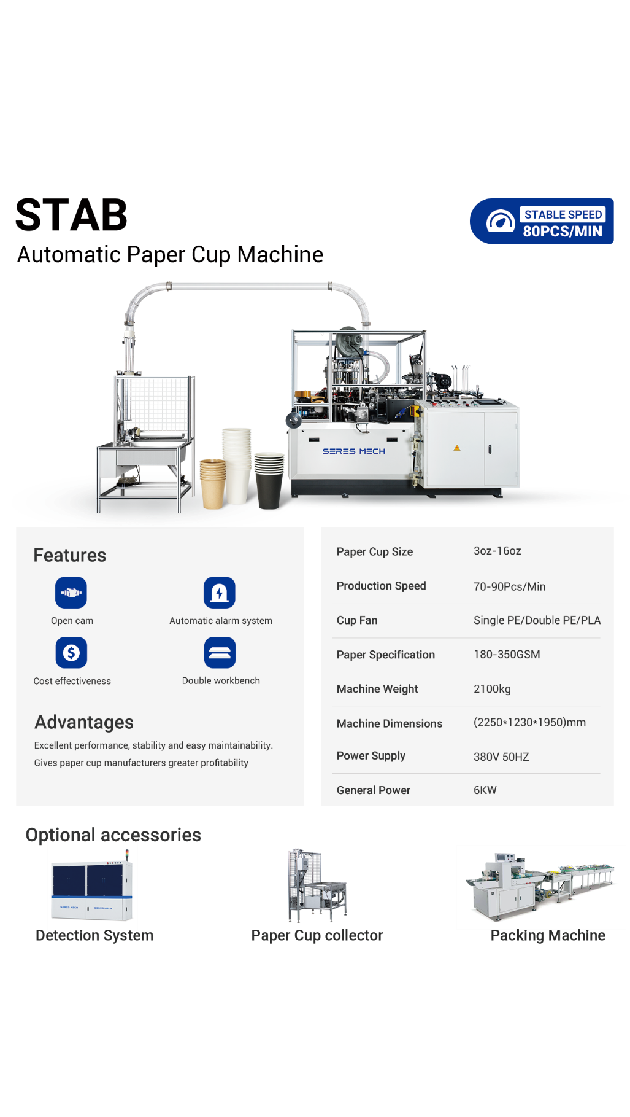
OPTIONAL EQUIPMENT
Contact: +8613506671537(wechat/whatapp)
Email: Betty@bettycdhk.com
Address: Room 2202, Unit 1, Building 12, Ruifengjingyuan, Anyang Street, Ruian City,
Wenzhou City, Zhejiang Province, China

Slide 8
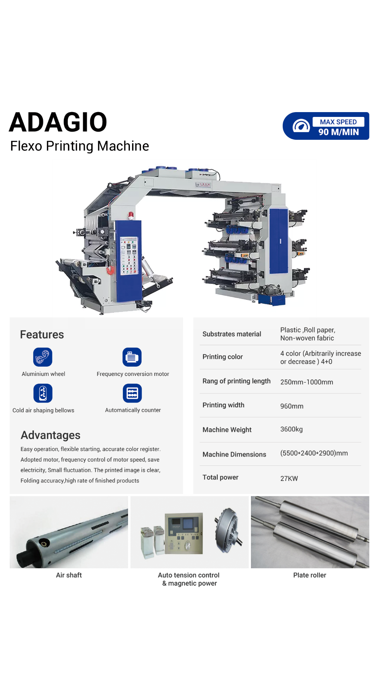

OPTIONAL EQUIPMENT
Contact: +8613506671537(wechat/whatapp)
Email: Betty@bettycdhk.com
Address: Room 2202, Unit 1, Building 12, Ruifengjingyuan, Anyang Street, Ruian City,
Wenzhou City, Zhejiang Province, China

Slide 9
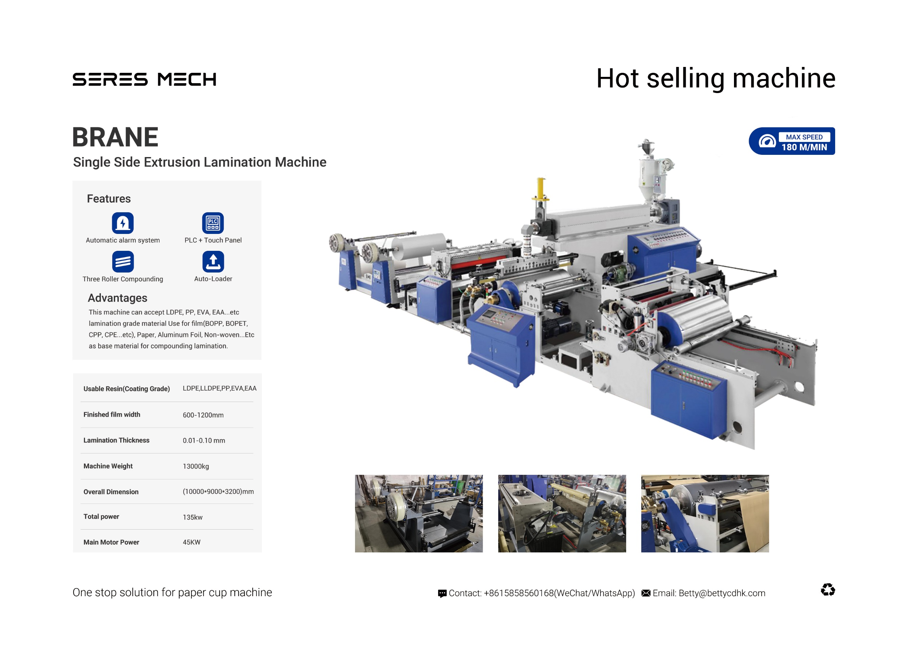
OPTIONAL EQUIPMENT
Contact: +8613506671537(wechat/whatapp)
Email: Betty@bettycdhk.com
Address: Room 2202, Unit 1, Building 12, Ruifengjingyuan, Anyang Street, Ruian City,
Wenzhou City, Zhejiang Province, China

Slide 10
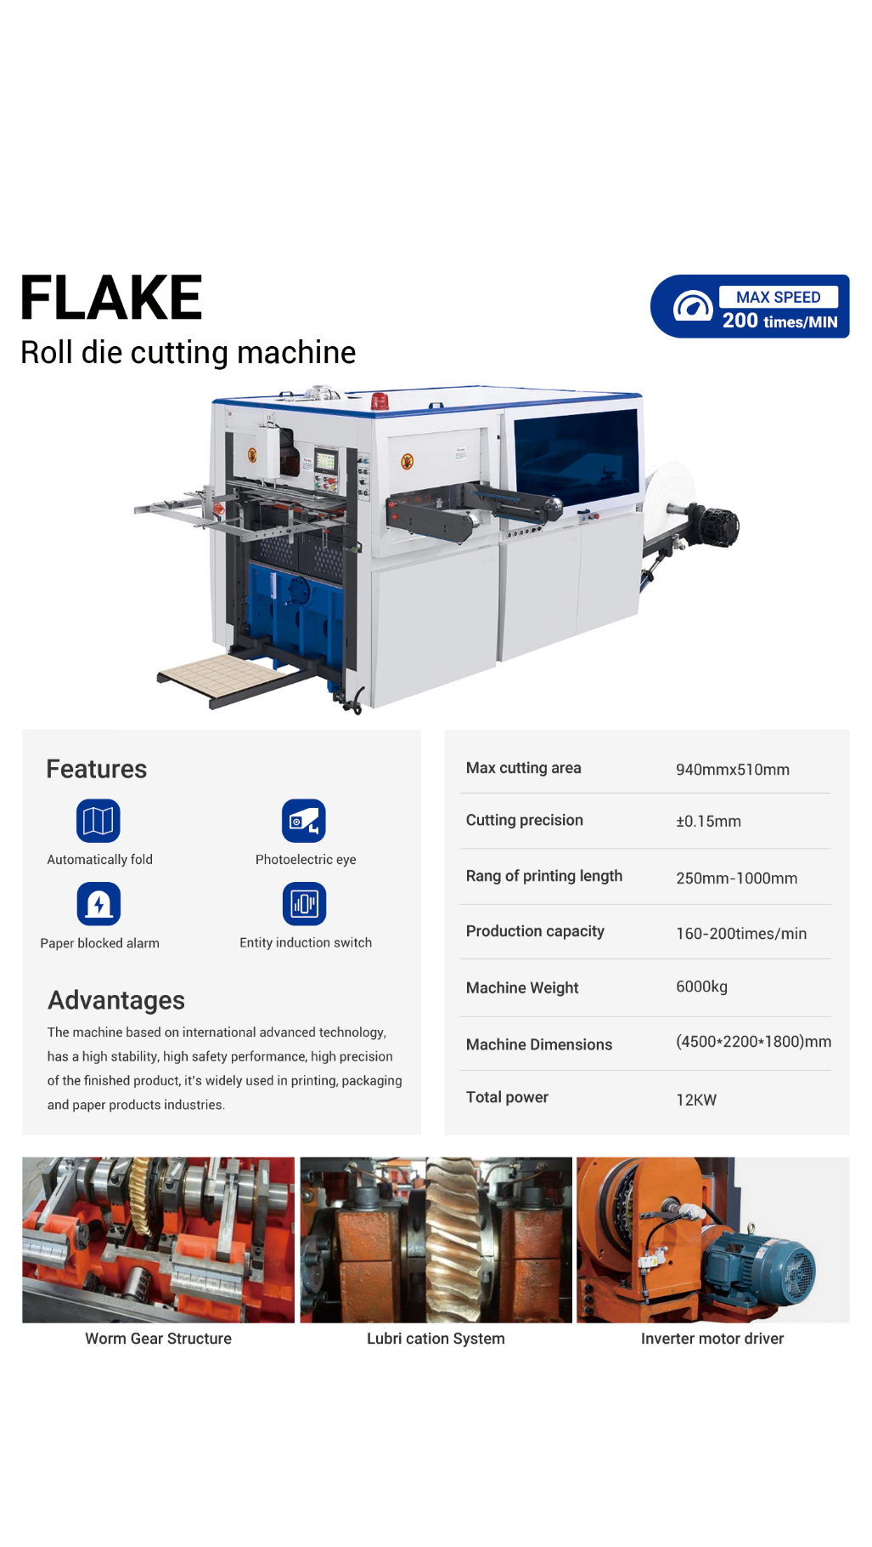
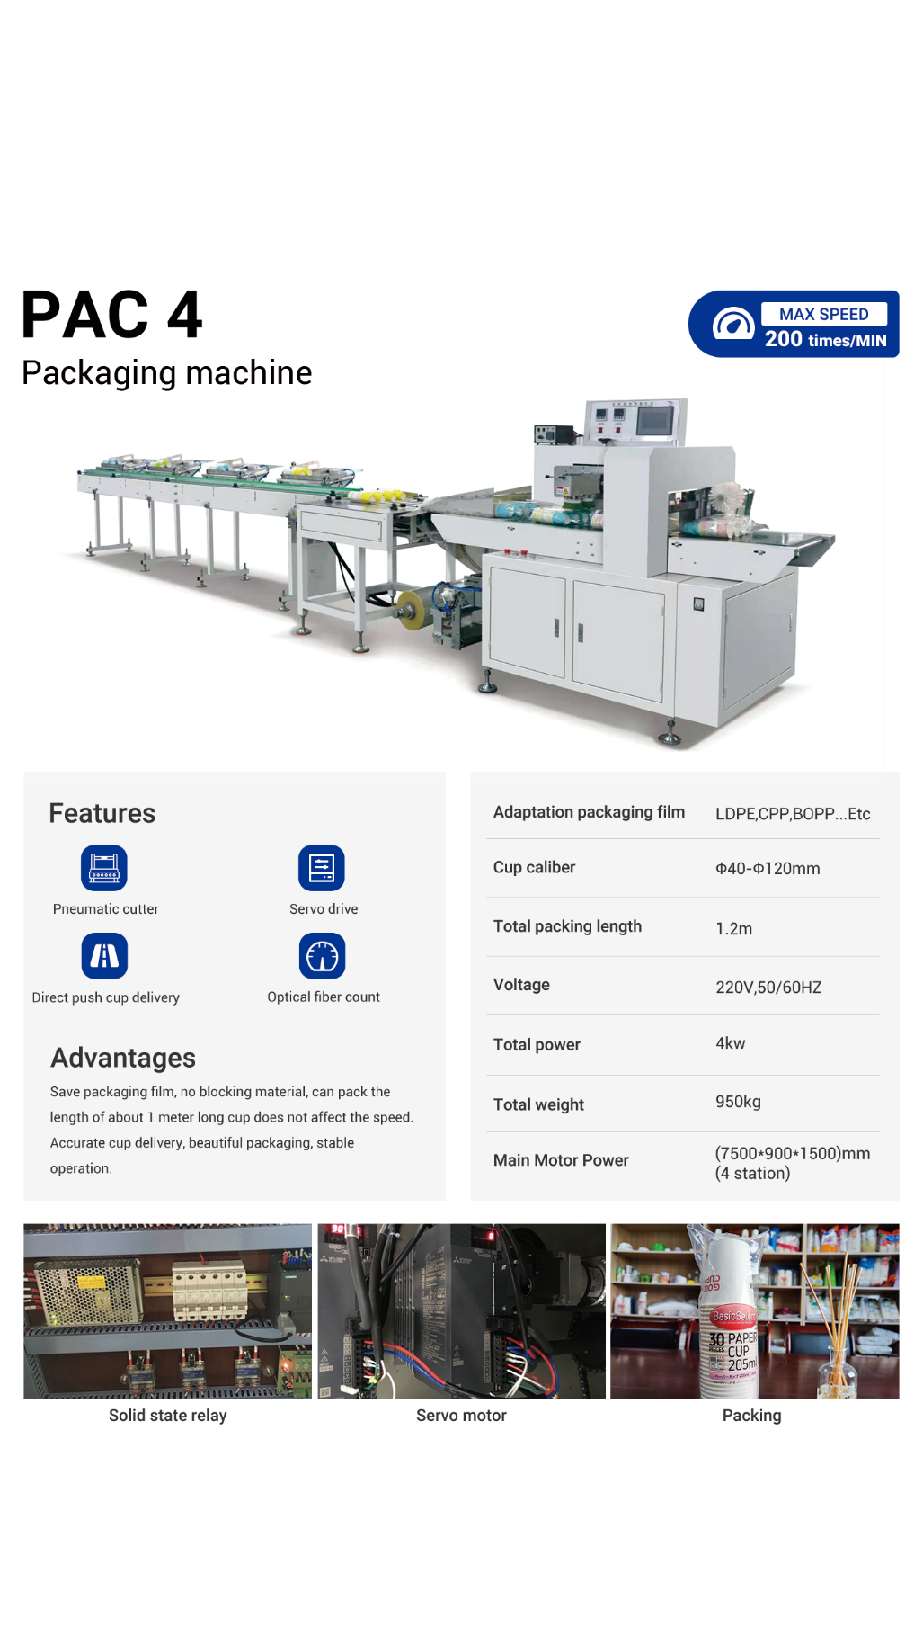
OPTIONAL EQUIPMENT
Contact: +8613506671537(wechat/whatapp)
Email: Betty@bettycdhk.com
Address: Room 2202, Unit 1, Building 12, Ruifengjingyuan, Anyang Street, Ruian City,
Wenzhou City, Zhejiang Province, China

Slide 11
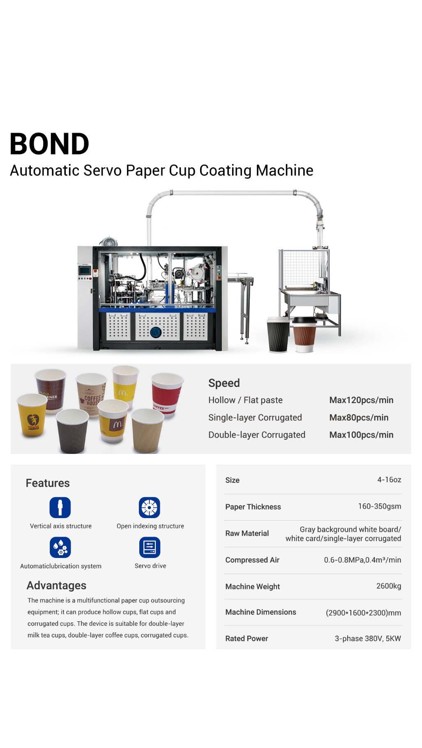
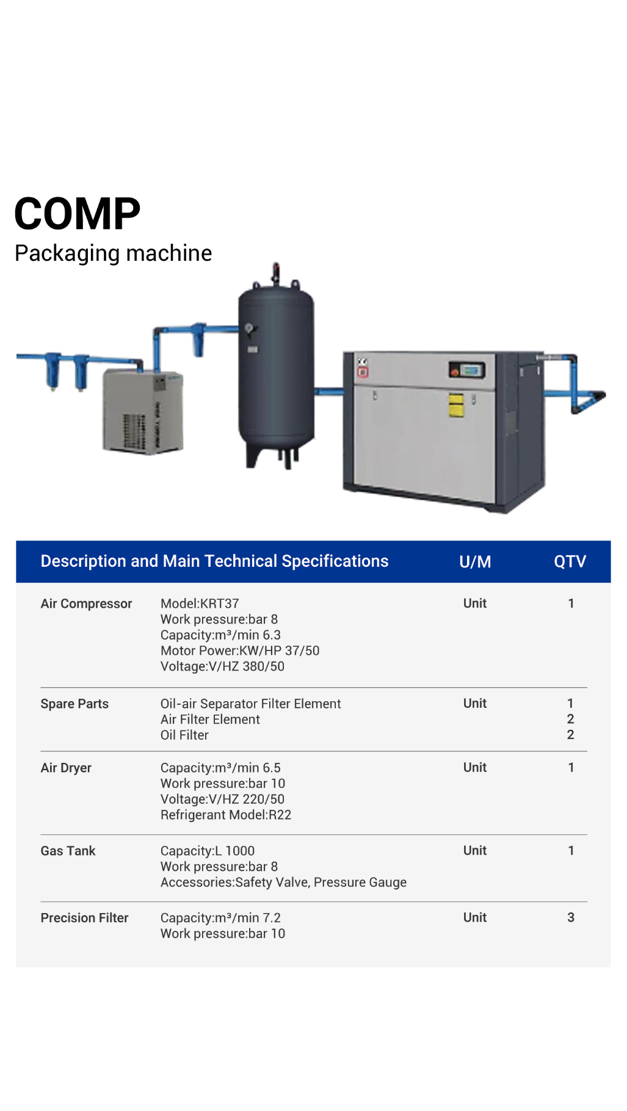
OPTIONAL EQUIPMENT
Contact: +8613506671537(wechat/whatapp)
Email: Betty@bettycdhk.com
Address: Room 2202, Unit 1, Building 12, Ruifengjingyuan, Anyang Street, Ruian City,
Wenzhou City, Zhejiang Province, China

Slide 12
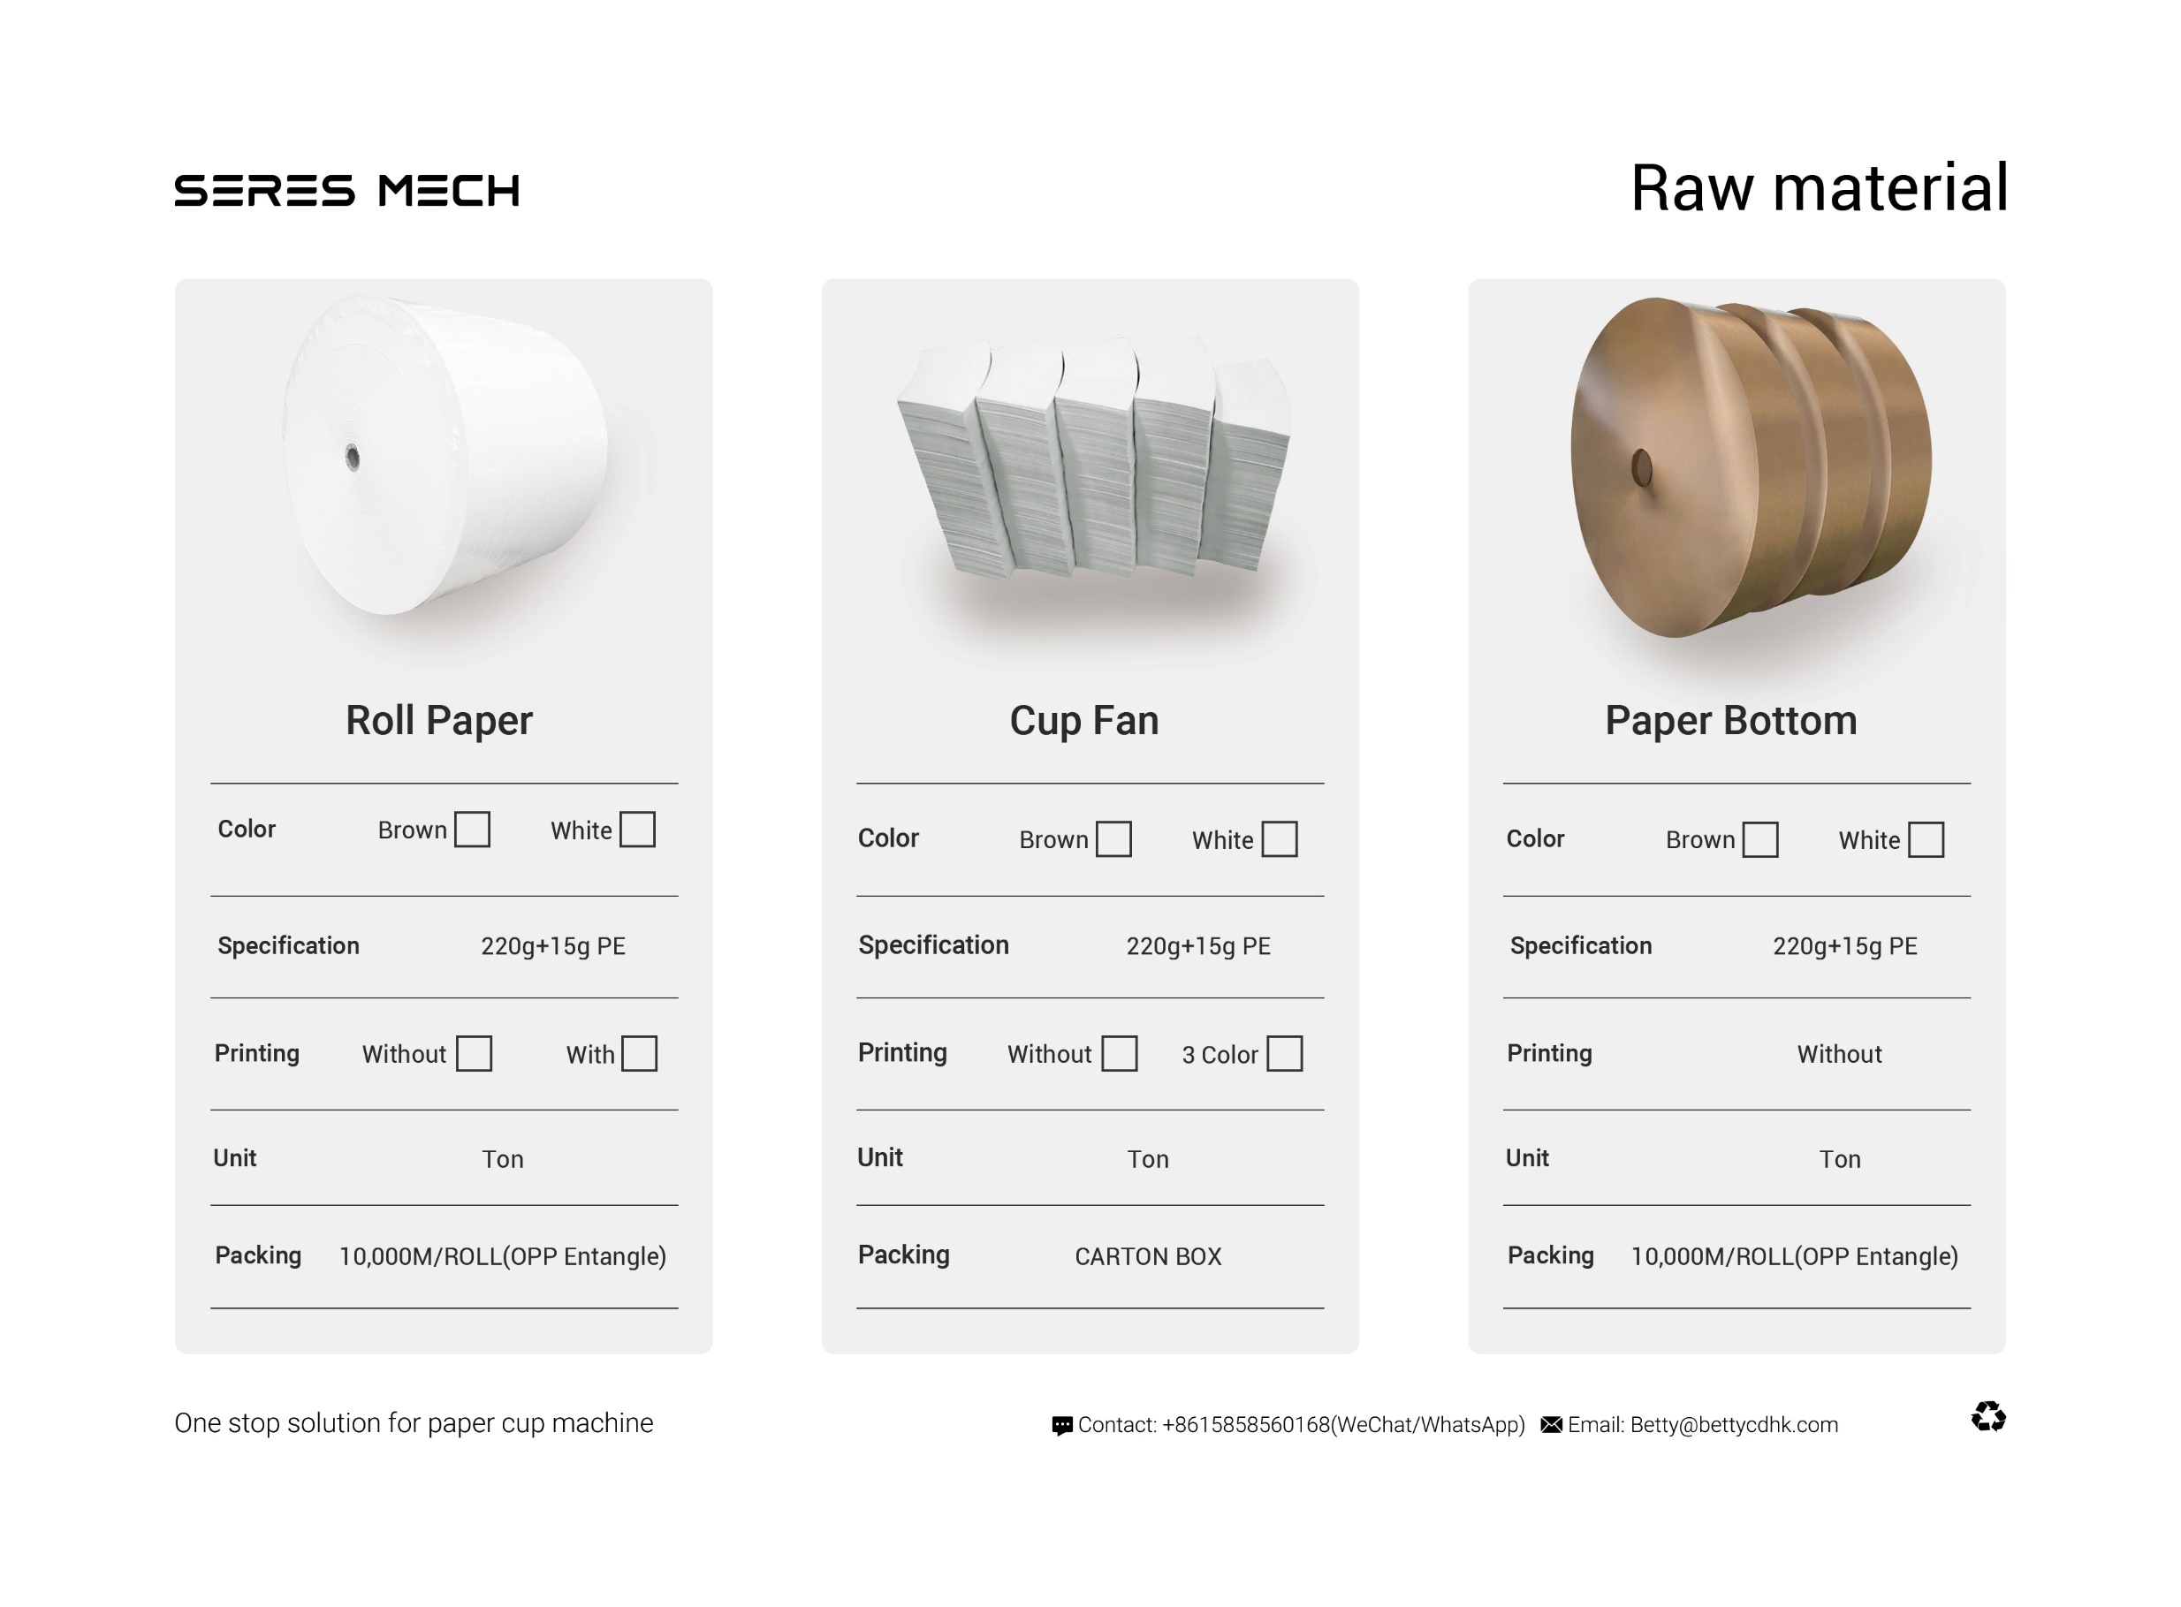
OPTIONAL EQUIPMENT
Contact: +8613506671537(wechat/whatapp)
Email: Betty@bettycdhk.com
Address: Room 2202, Unit 1, Building 12, Ruifengjingyuan, Anyang Street, Ruian City,
Wenzhou City, Zhejiang Province, China

Slide 13
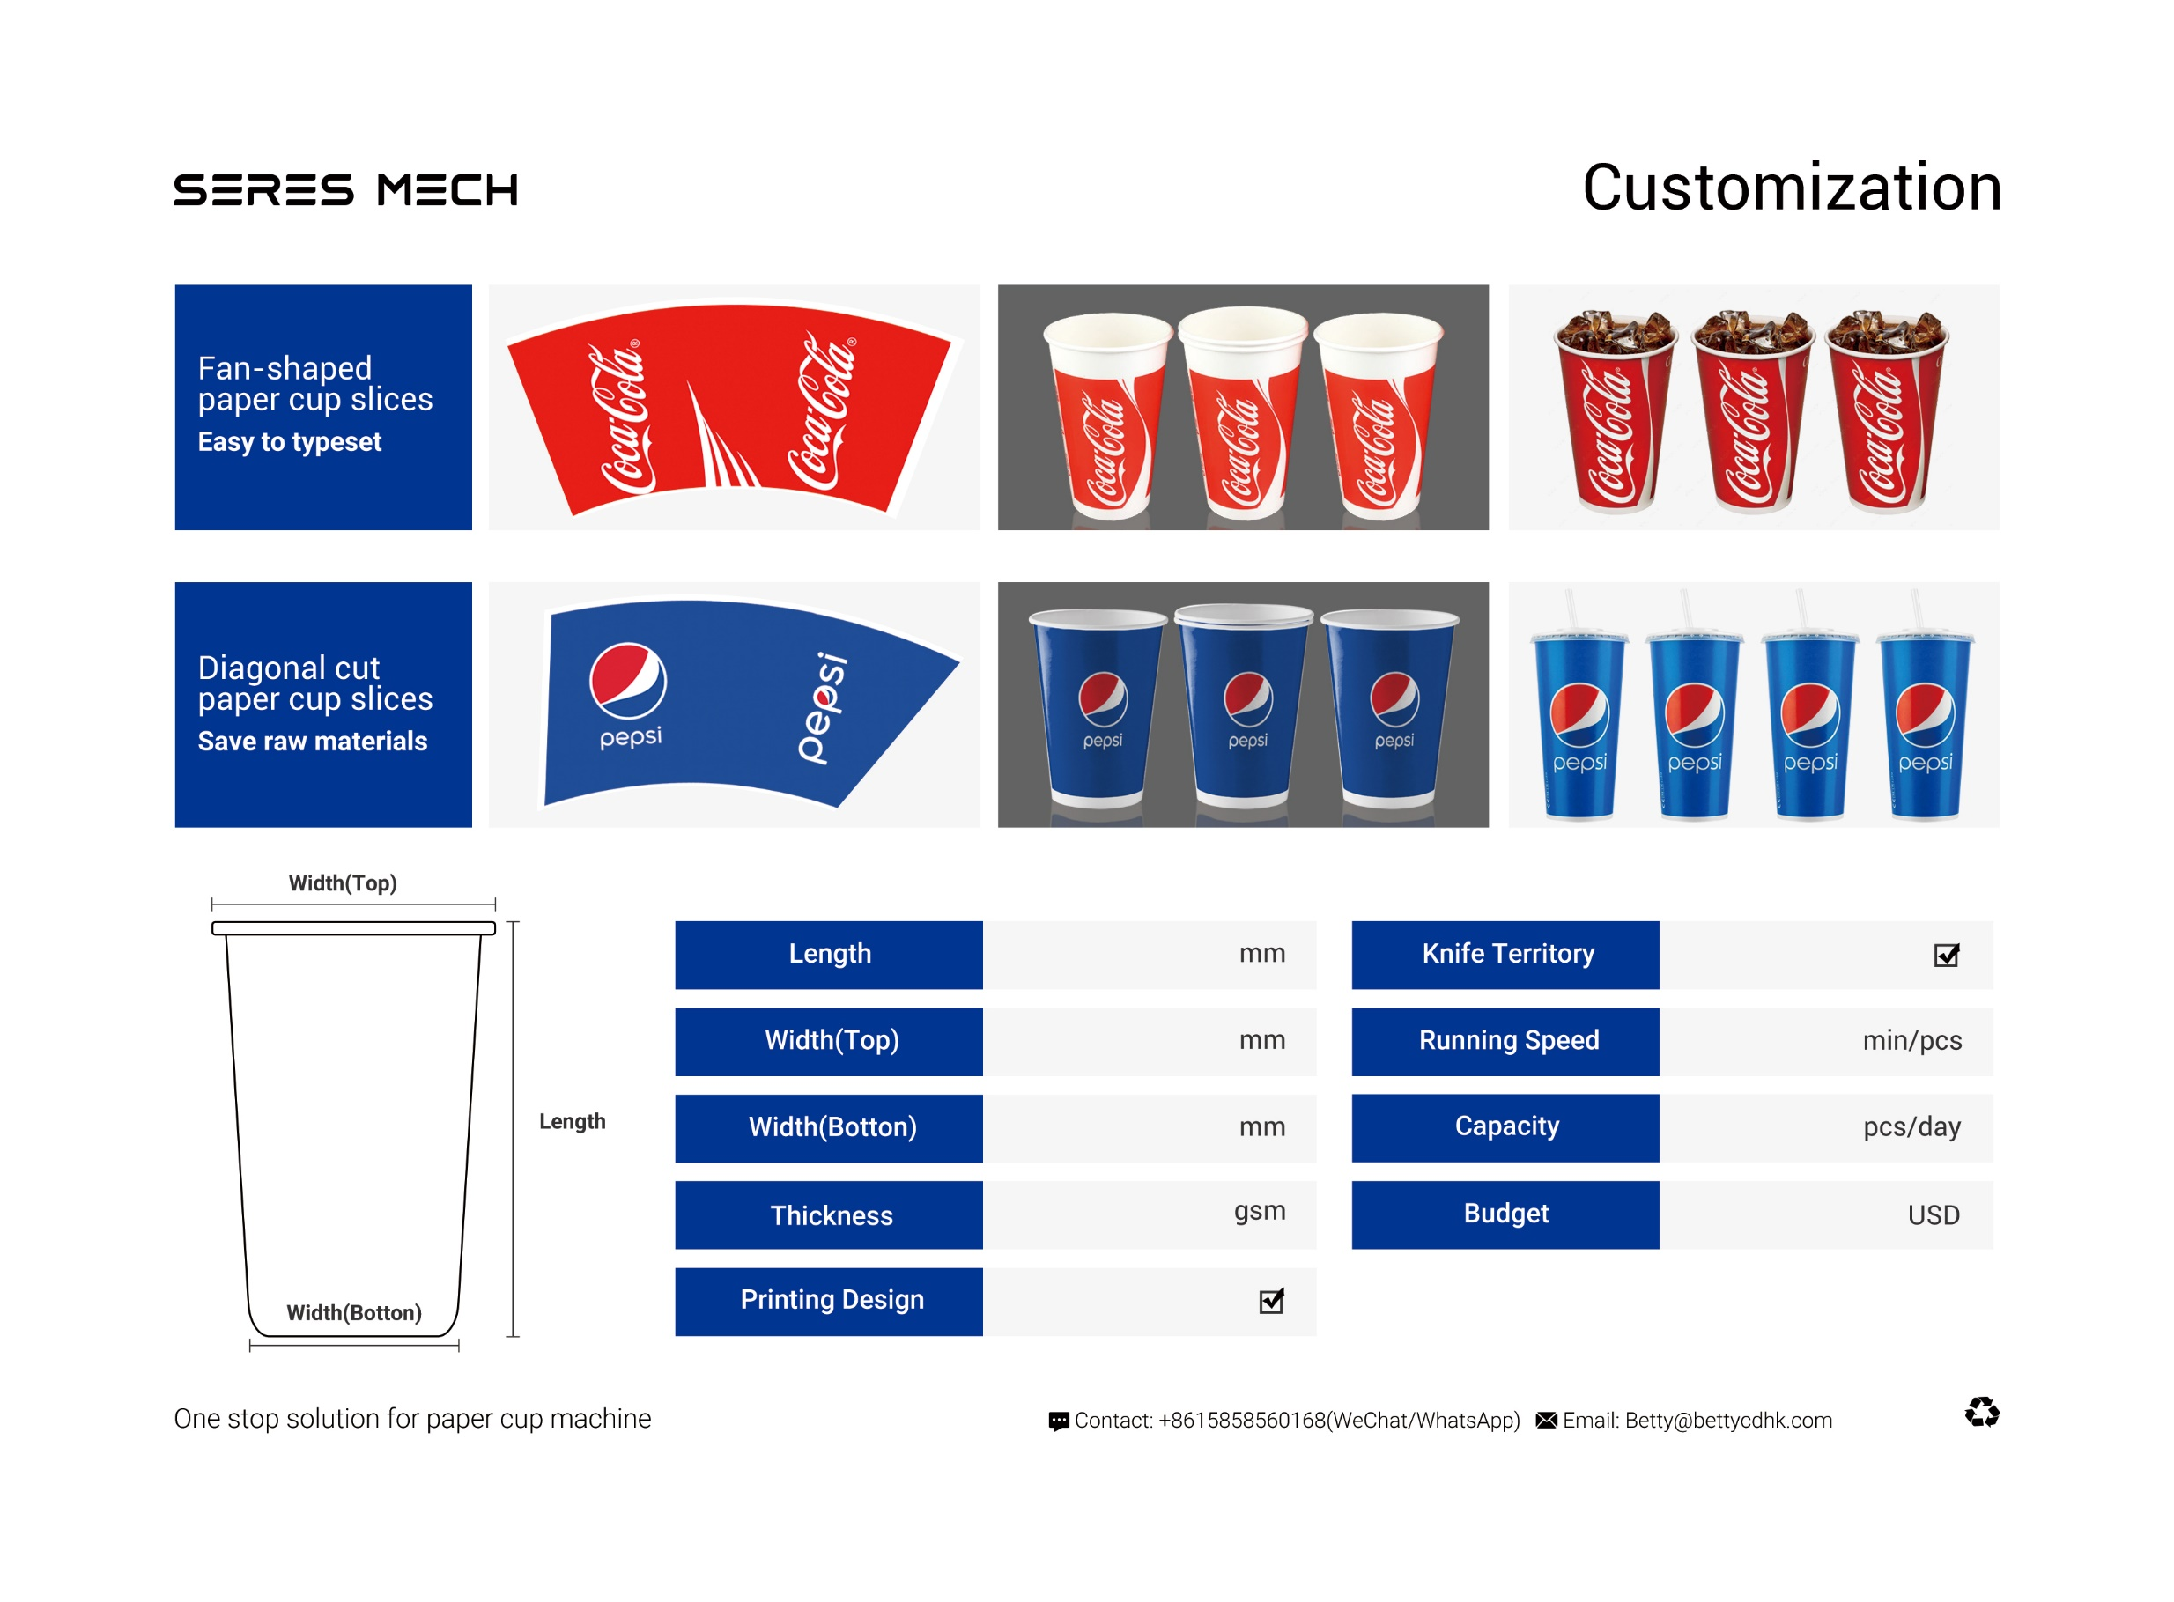
OPTIONAL EQUIPMENT
Contact: +8613506671537(wechat/whatapp)
Email: Betty@bettycdhk.com
Address: Room 2202, Unit 1, Building 12, Ruifengjingyuan, Anyang Street, Ruian City,
Wenzhou City, Zhejiang Province, China

Slide 14
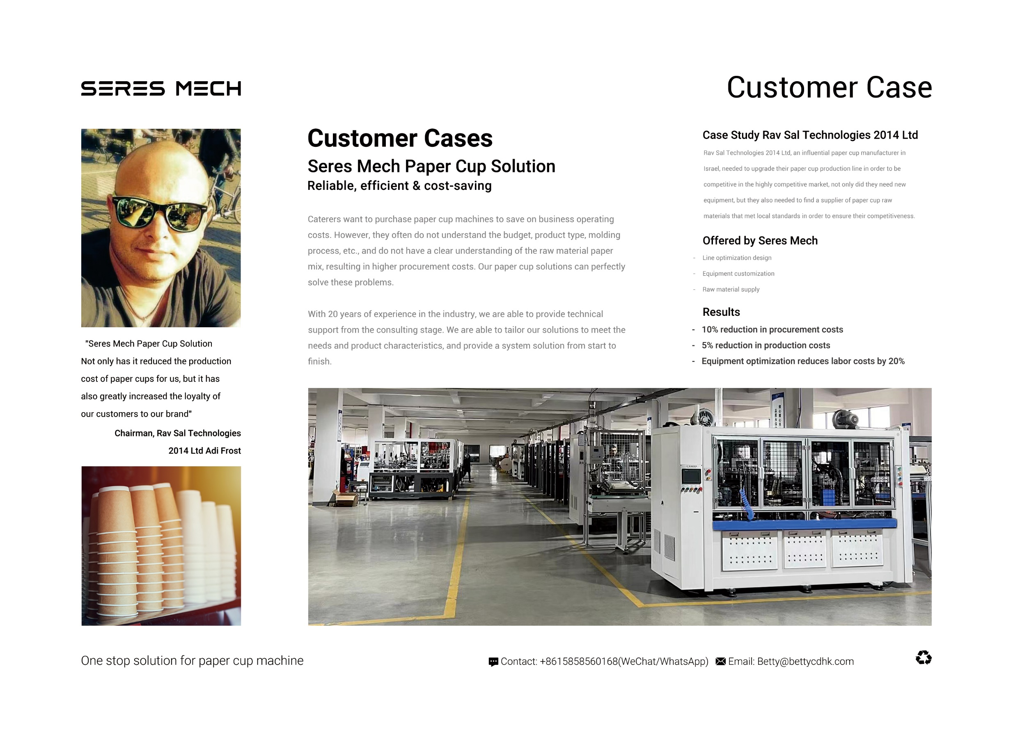
OPTIONAL EQUIPMENT
Contact: +8613506671537(wechat/whatapp)
Email: Betty@bettycdhk.com
Address: Room 2202, Unit 1, Building 12, Ruifengjingyuan, Anyang Street, Ruian City,
Wenzhou City, Zhejiang Province, China

Slide 15
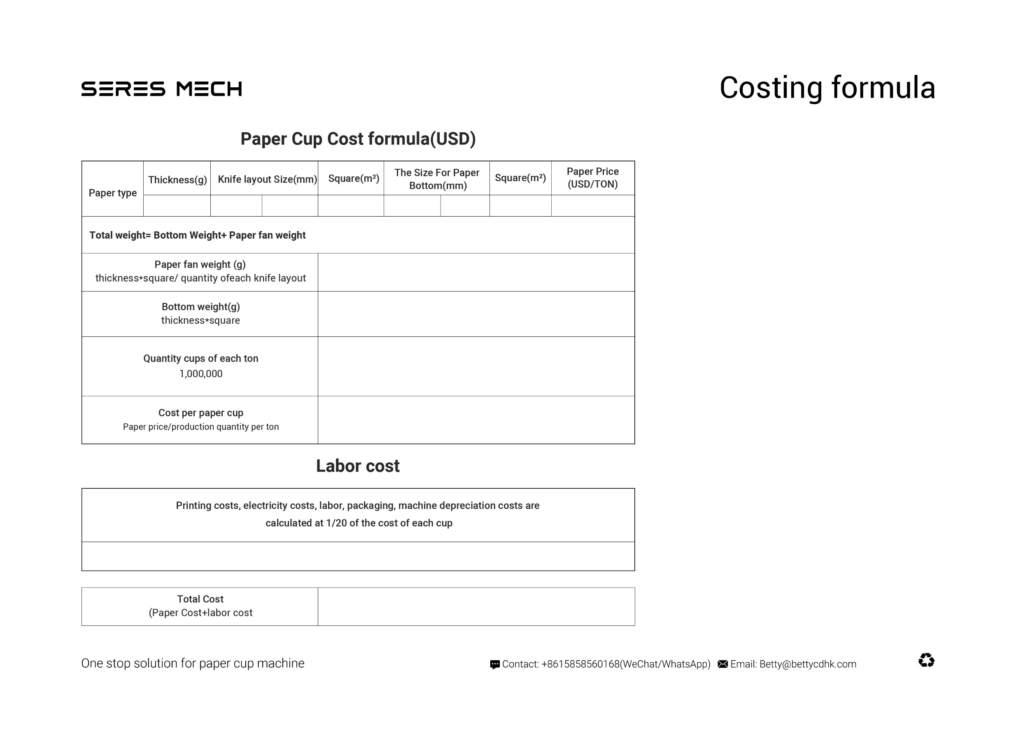
338
272.65
129.7
0.03536
75.4
76
0.0057
1450
11.9526
1.71912
73144
0.0198
0.0010
0.0208
Notes:
单层杯

Slide 16
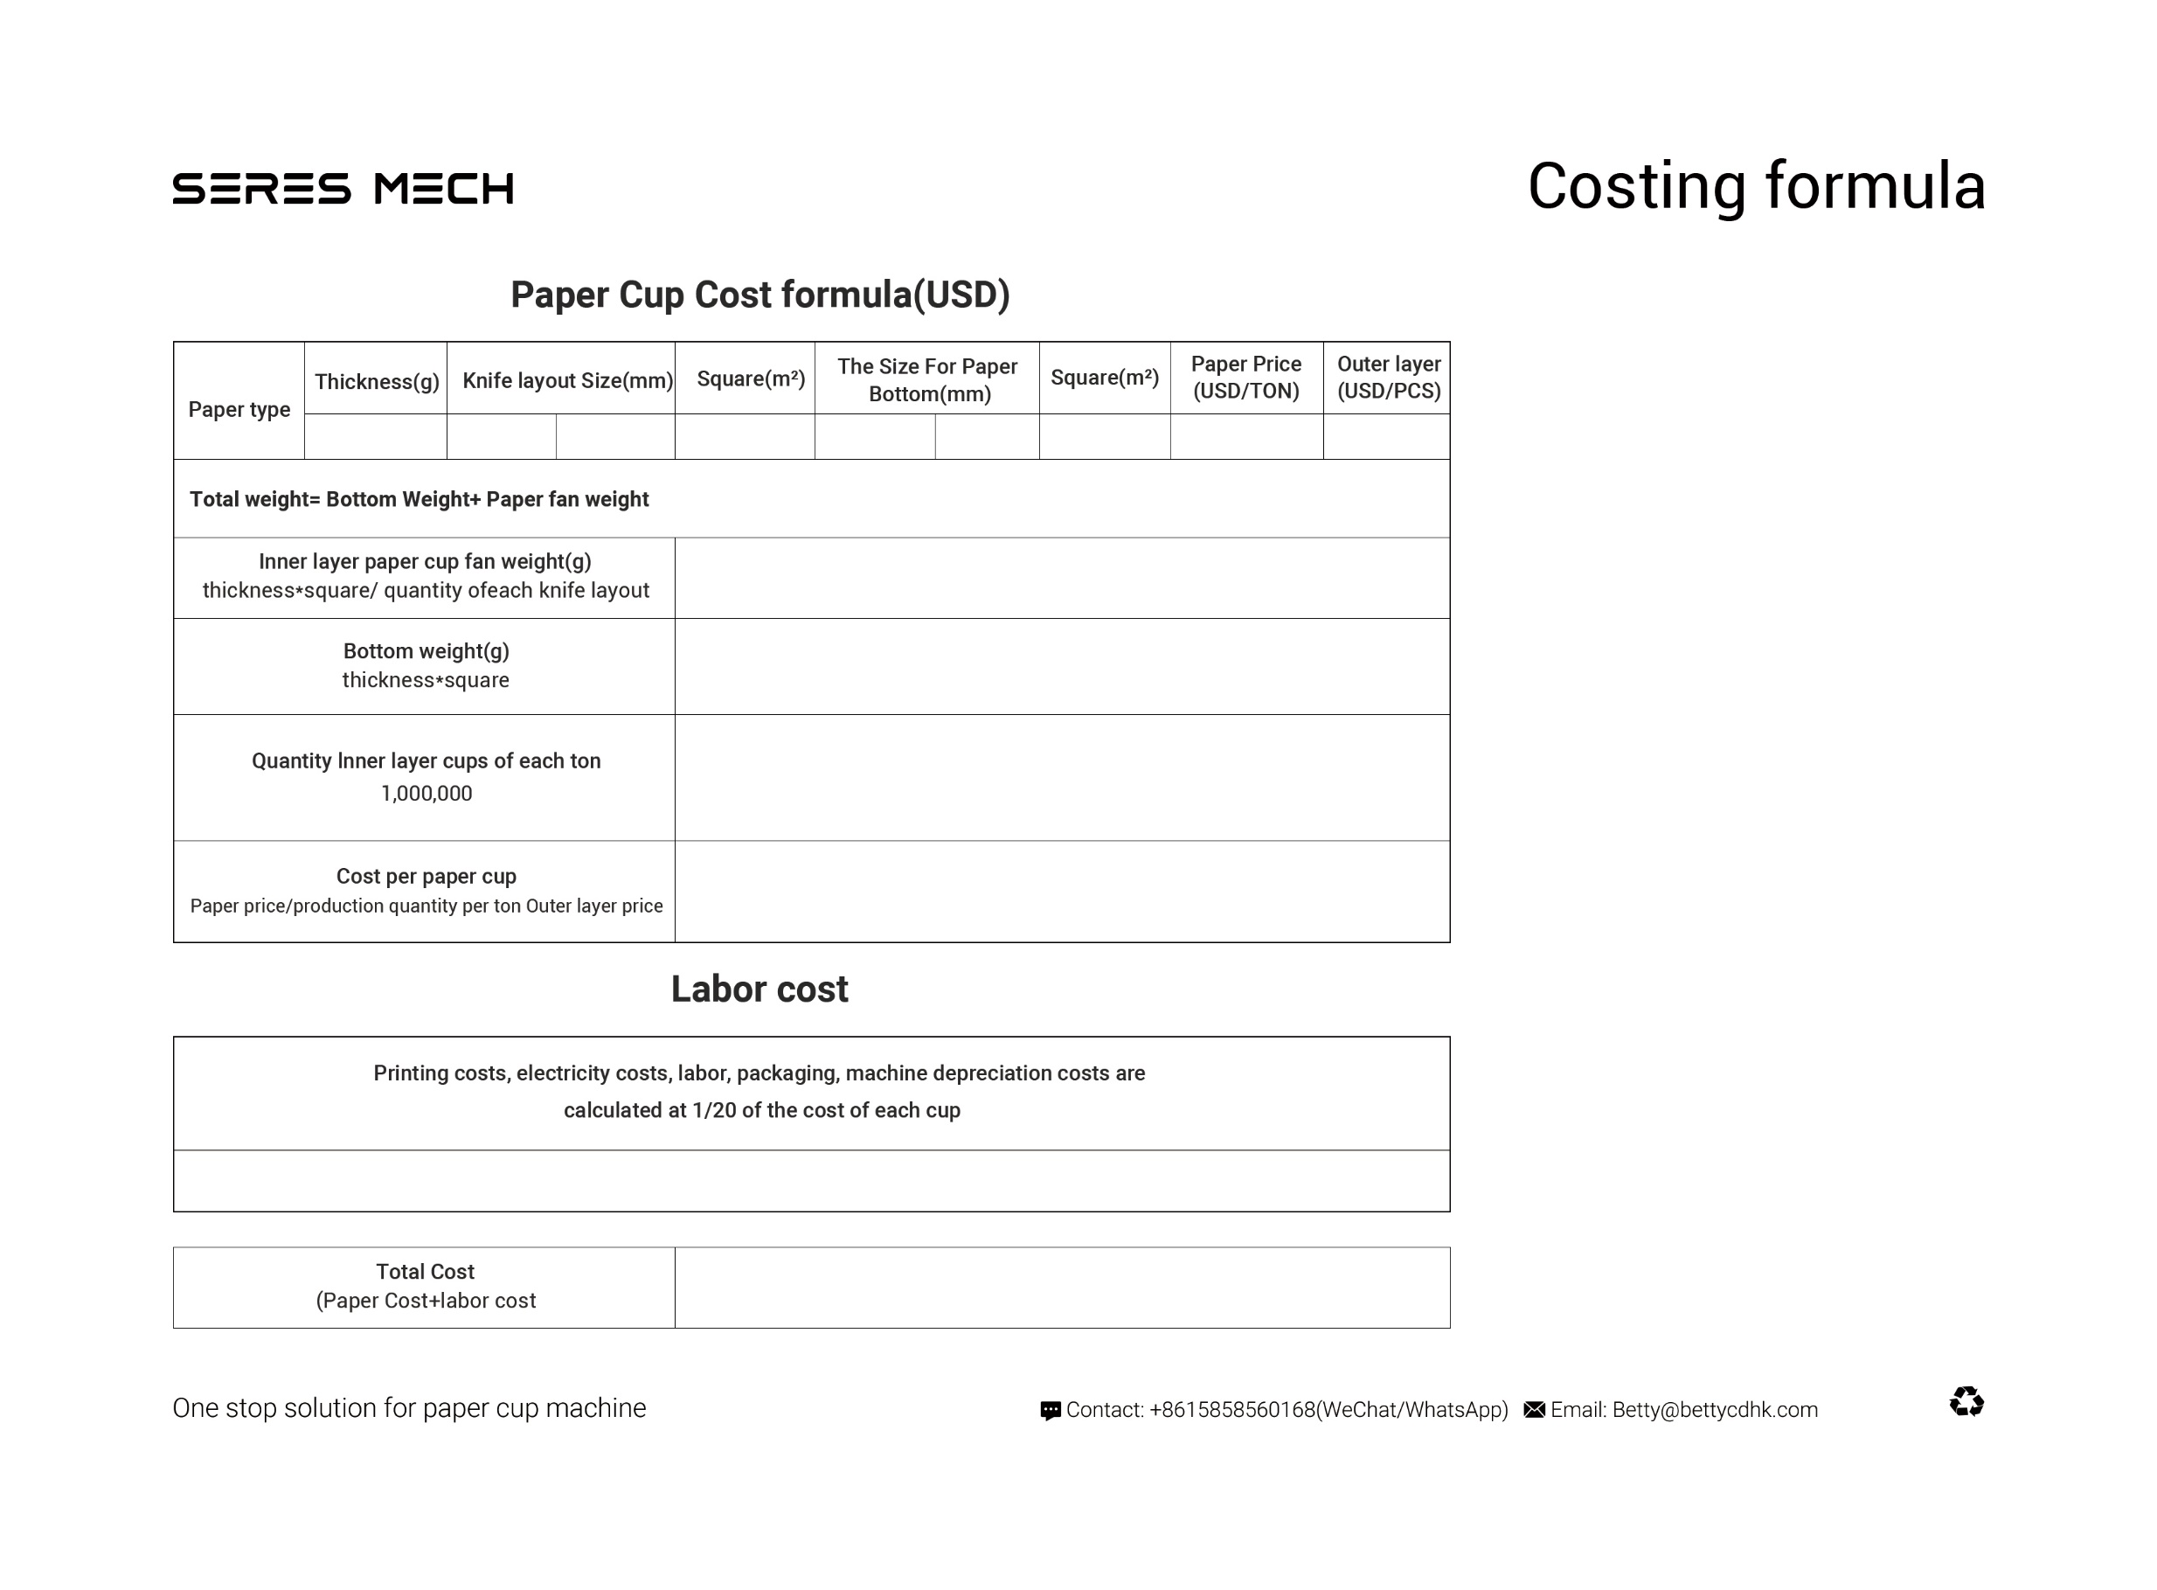
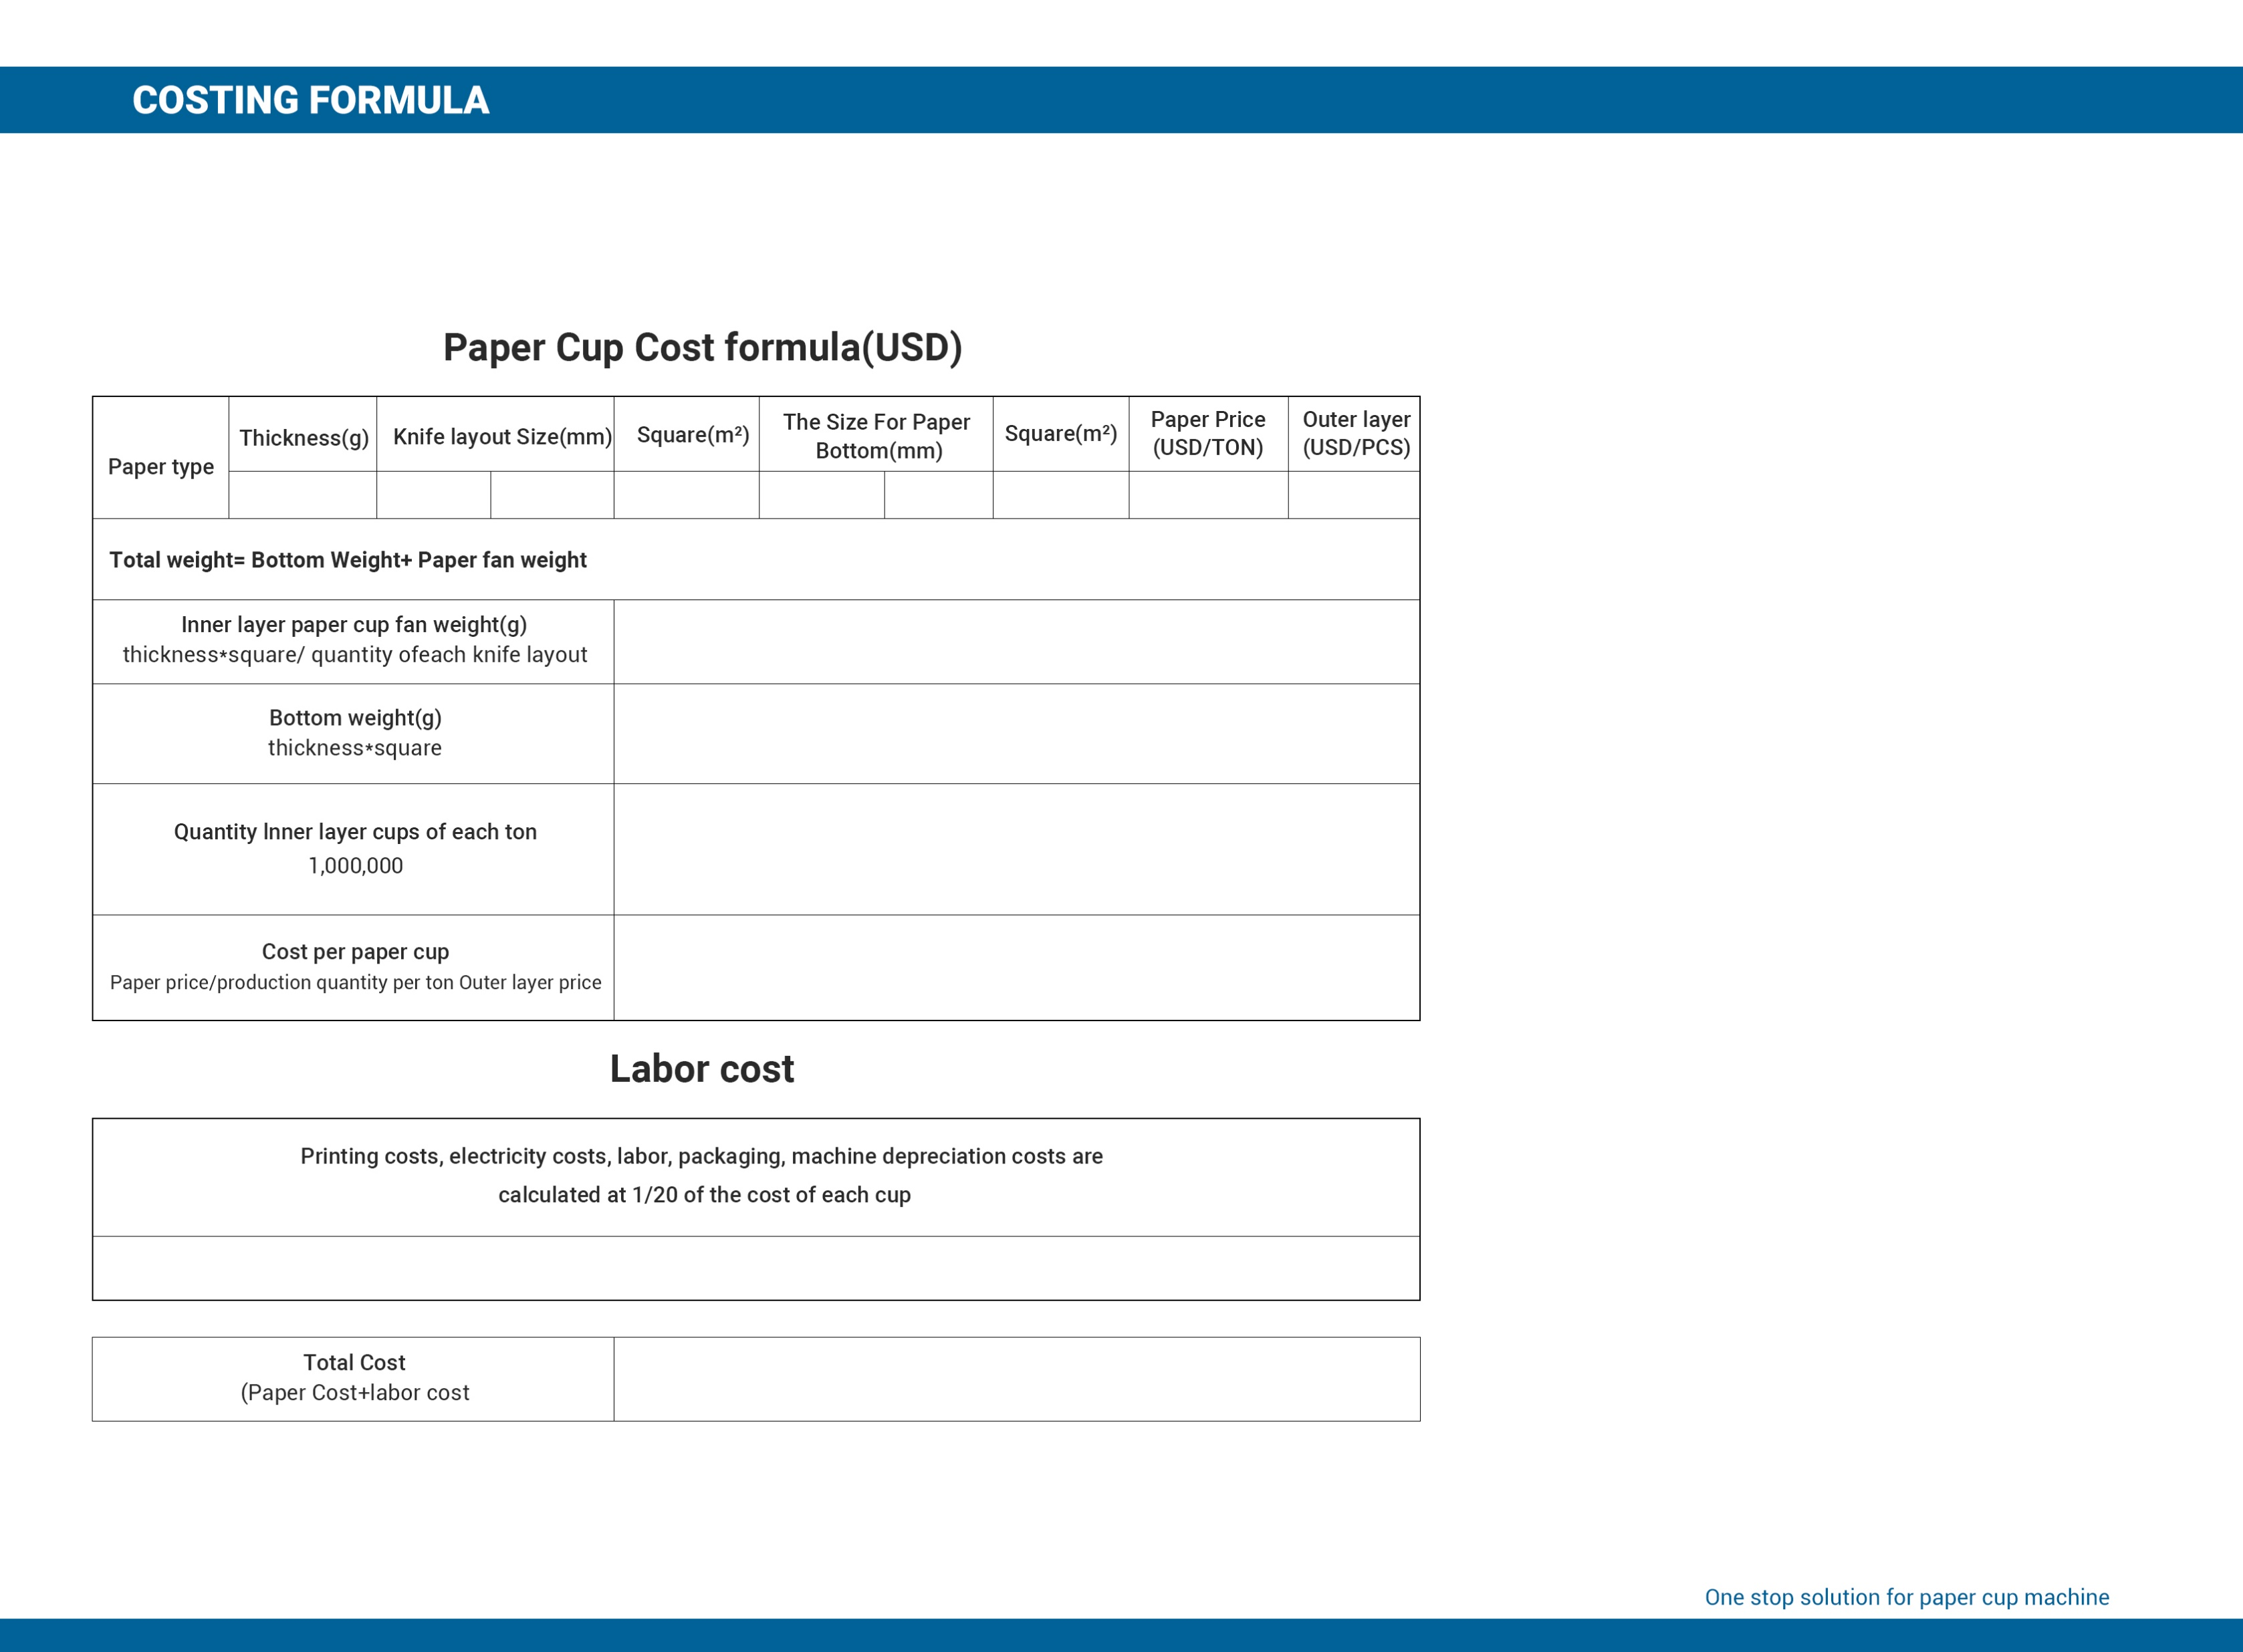
338
272.65
129.7
0.03536
75.4
76
0.0057
1450
1450
11.9526
1.71912
73144
0.0198
0.0010
0.0208
Notes:
双层杯

Slide 17
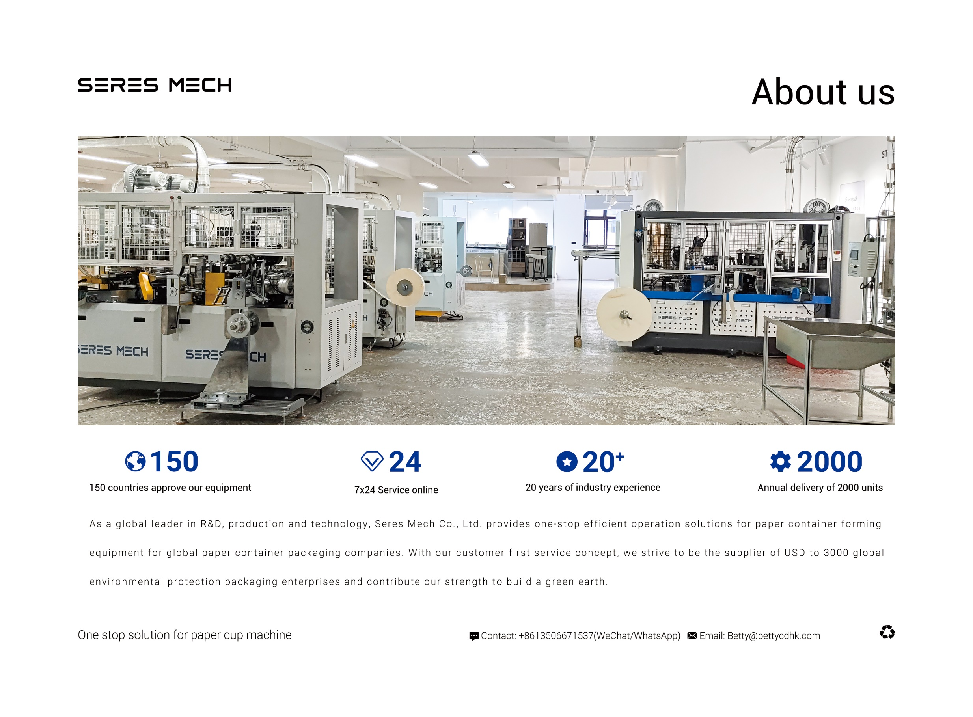
OPTIONAL EQUIPMENT
Contact: +8613506671537(wechat/whatapp)
Email: Betty@bettycdhk.com
Address: Room 2202, Unit 1, Building 12, Ruifengjingyuan, Anyang Street, Ruian City,
Wenzhou City, Zhejiang Province, China

Slide 18

OPTIONAL EQUIPMENT
Contact: +8613506671537(wechat/whatapp)
Email: Betty@bettycdhk.com
Address: Room 2202, Unit 1, Building 12, Ruifengjingyuan, Anyang Street, Ruian City,
Wenzhou City, Zhejiang Province, China

Slide 19
